Slide 1
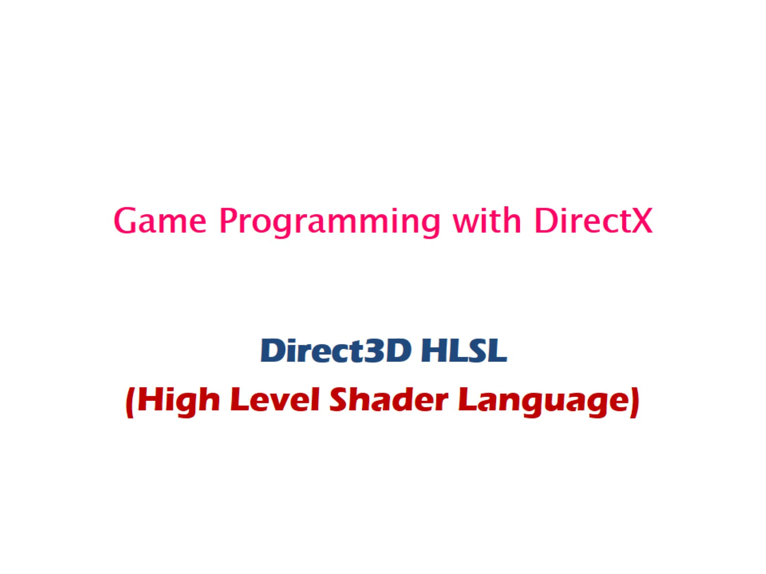
Game Programming with DirectX

Slide 2
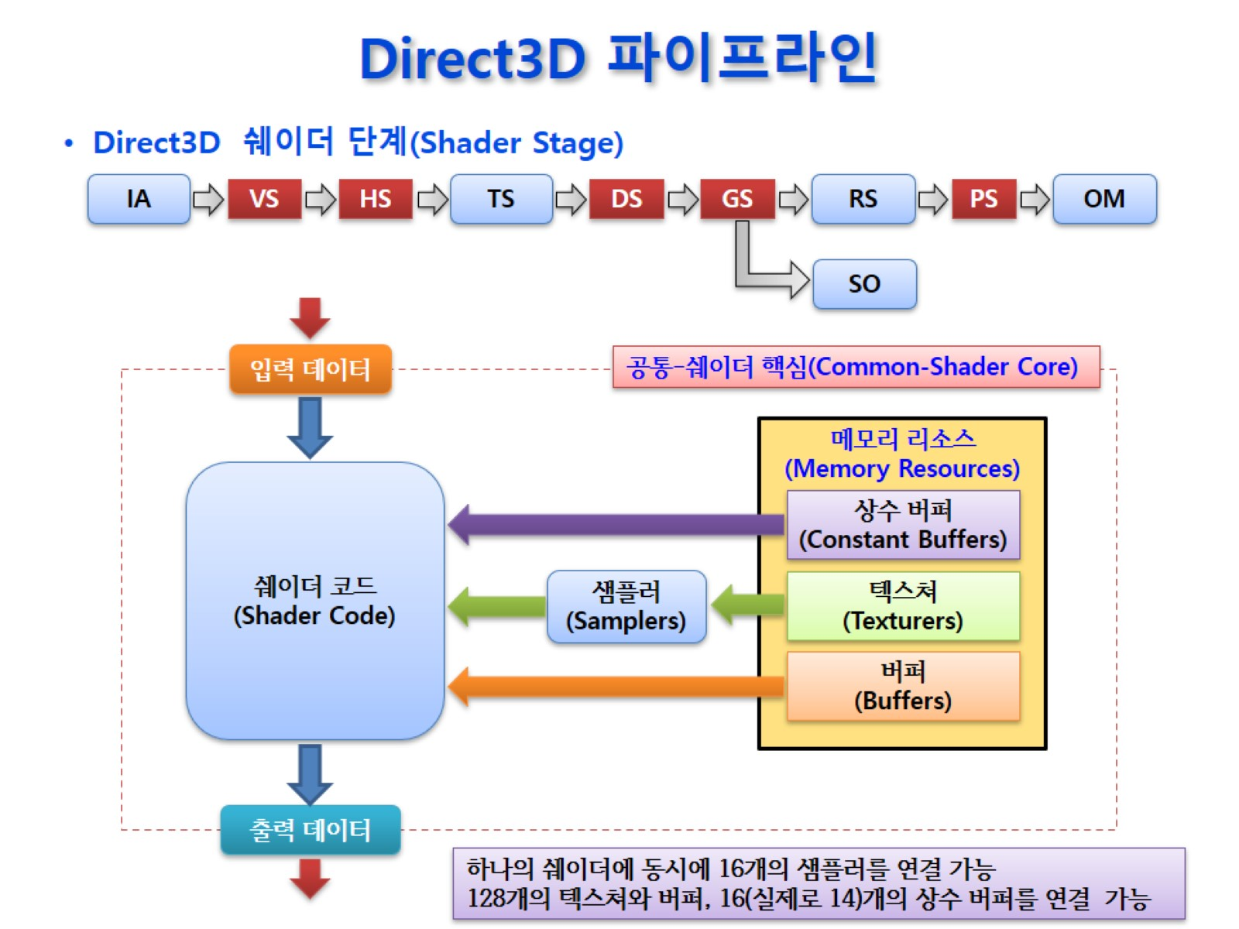
Direct3D 파이프라인

Slide 3
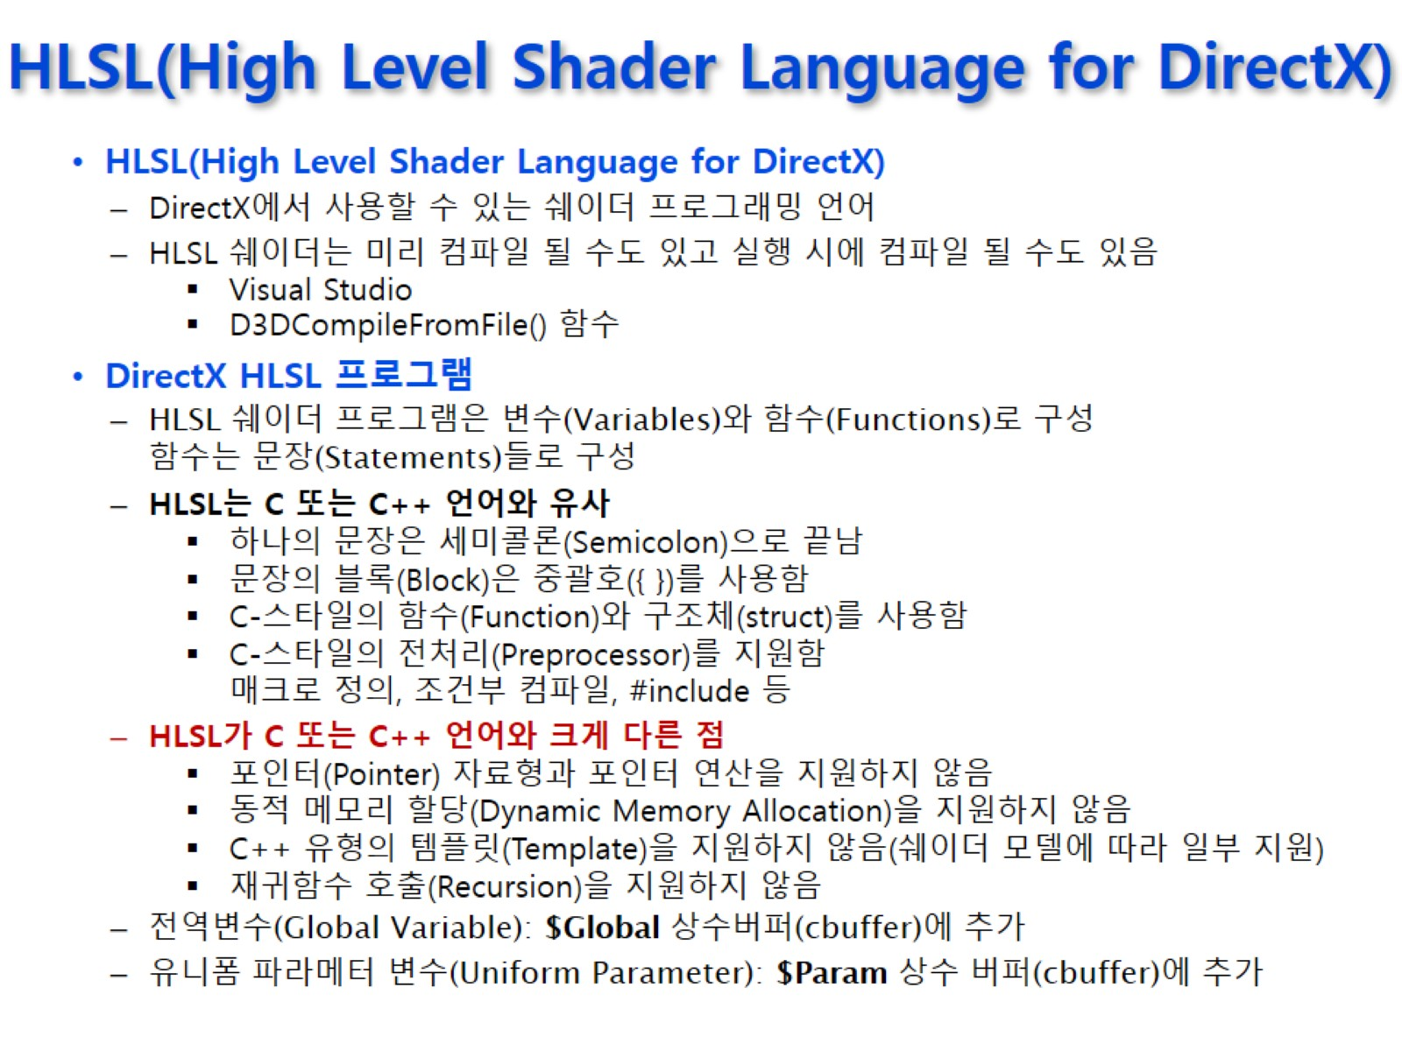
HLSL(High Level Shader Language for DirectX)

Slide 4
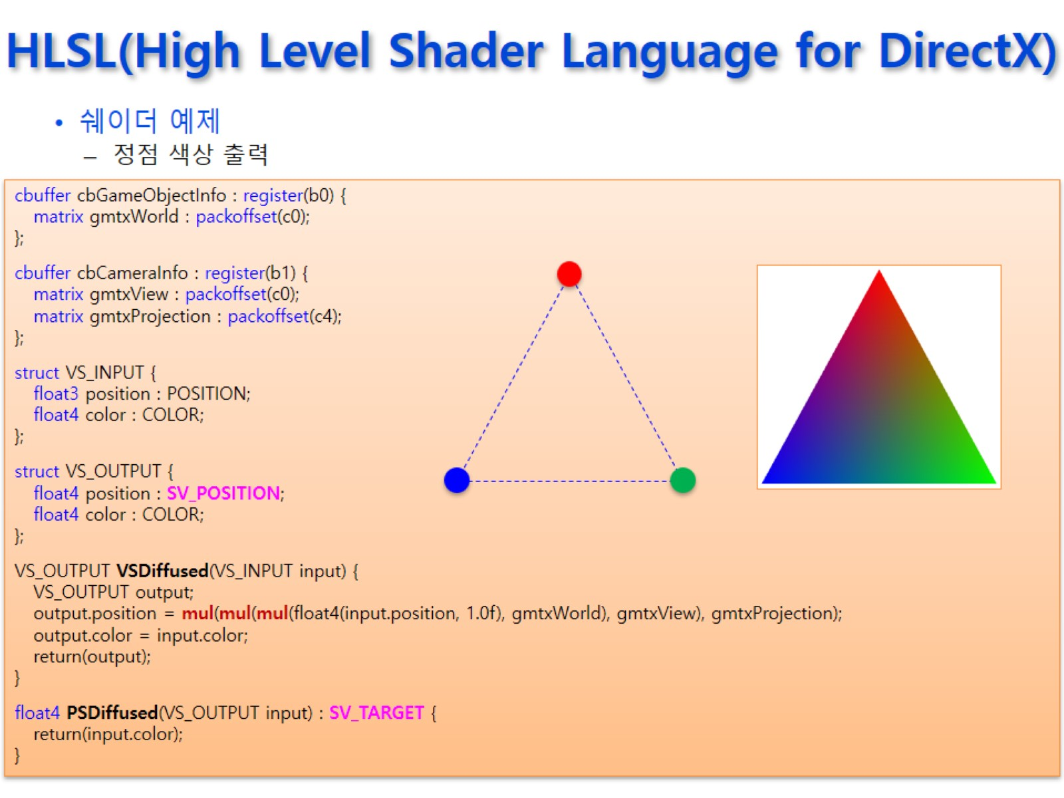
HLSL(High Level Shader Language for DirectX)

Slide 5
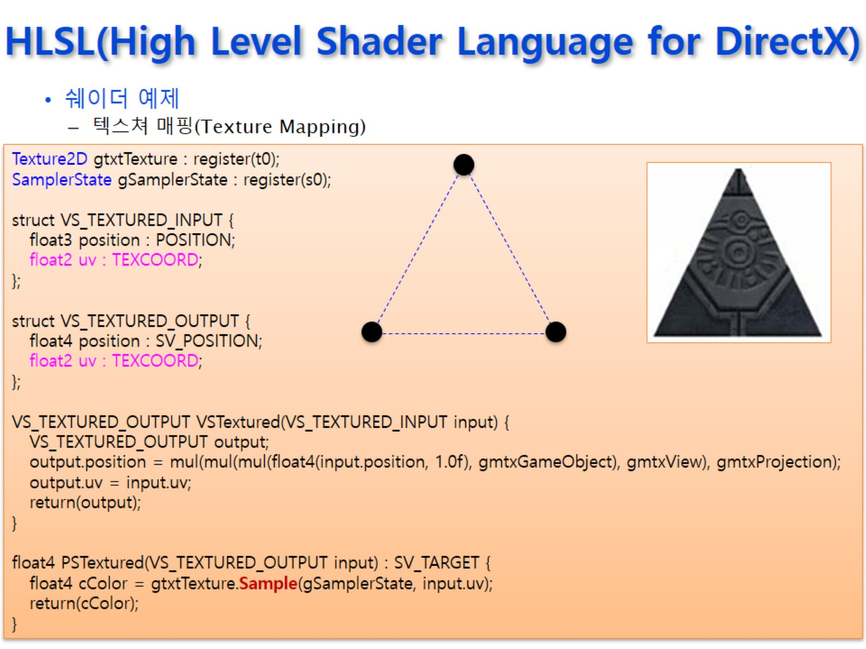
HLSL(High Level Shader Language for DirectX)

Slide 6
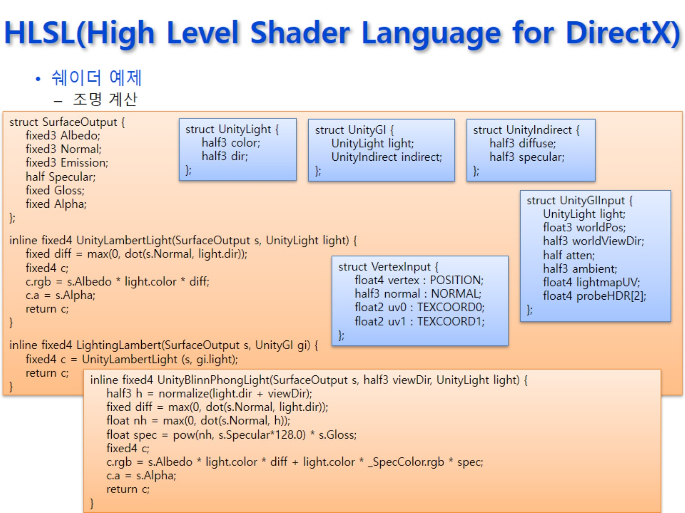
HLSL(High Level Shader Language for DirectX)

Slide 7
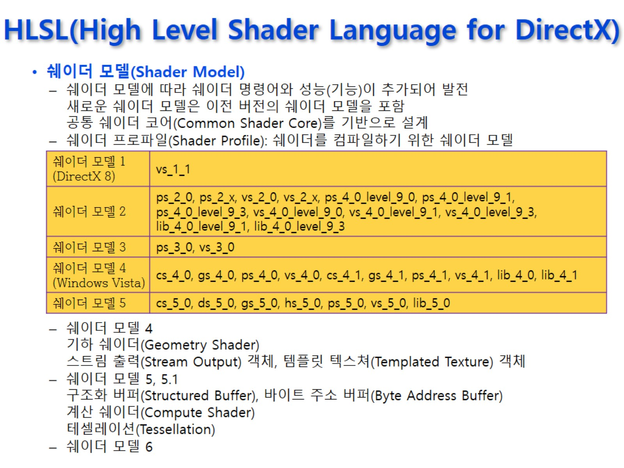
HLSL(High Level Shader Language for DirectX)

Slide 8
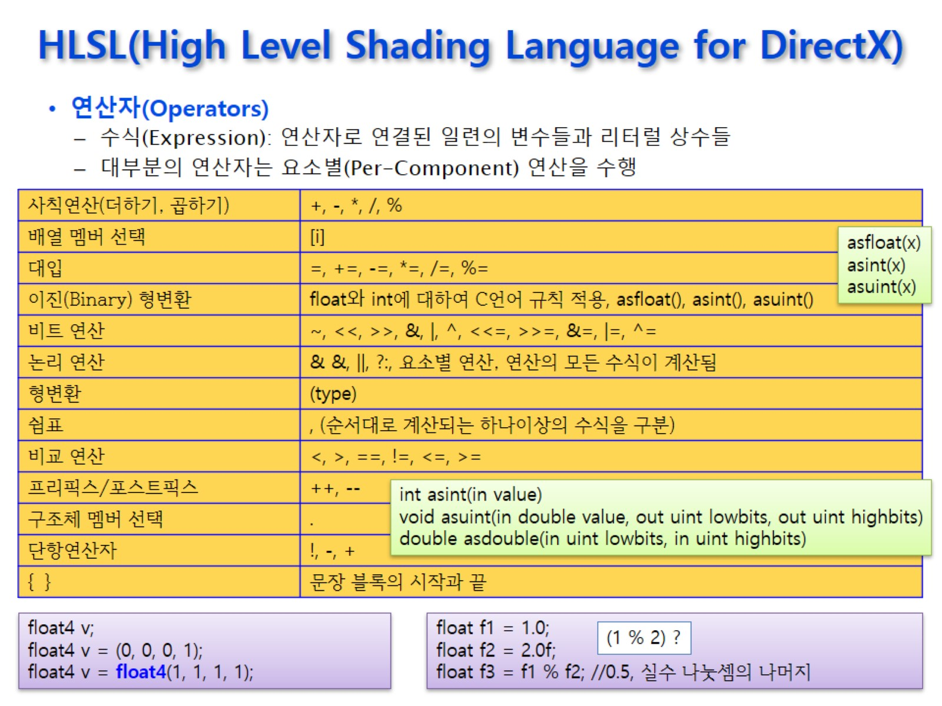
HLSL(High Level Shading Language for DirectX)

Slide 9
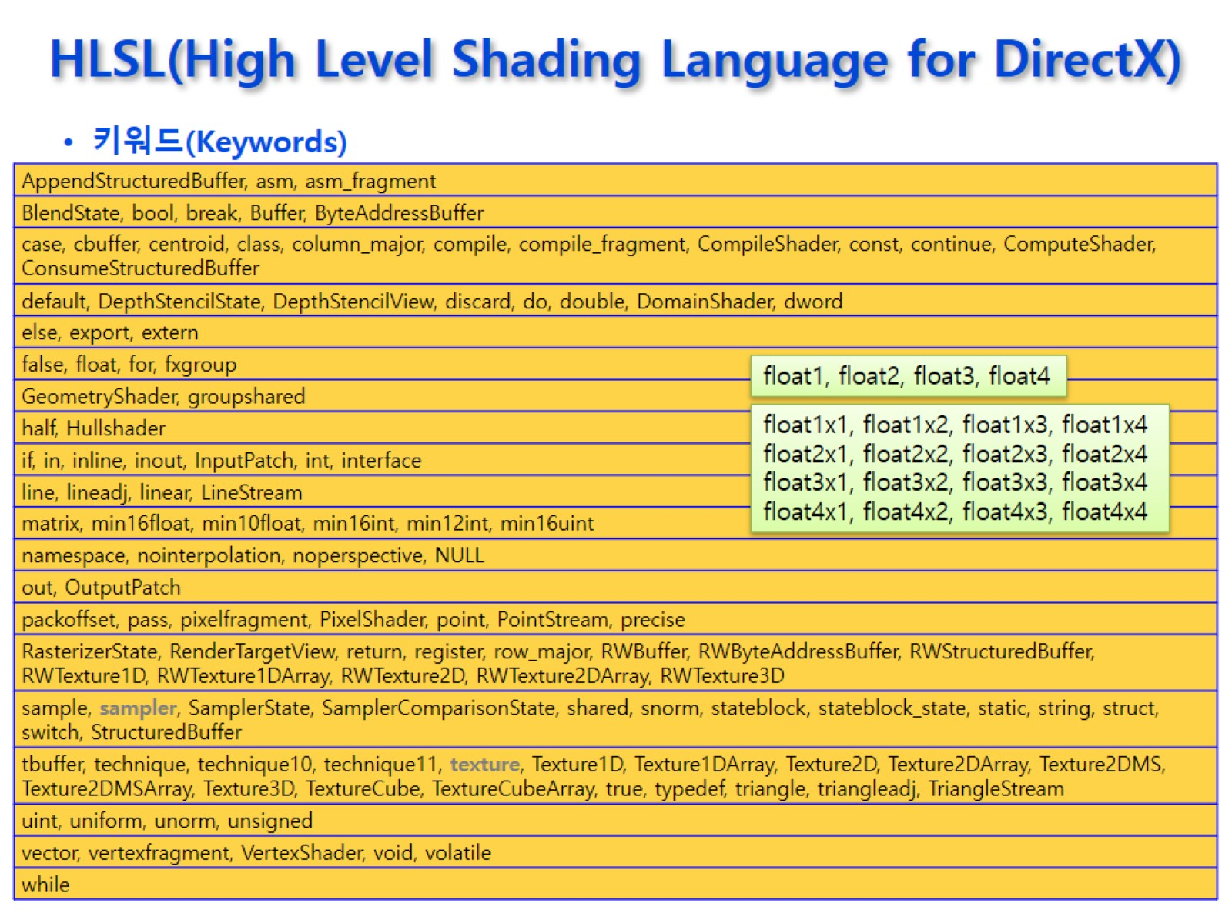
HLSL(High Level Shading Language for DirectX)

Slide 10
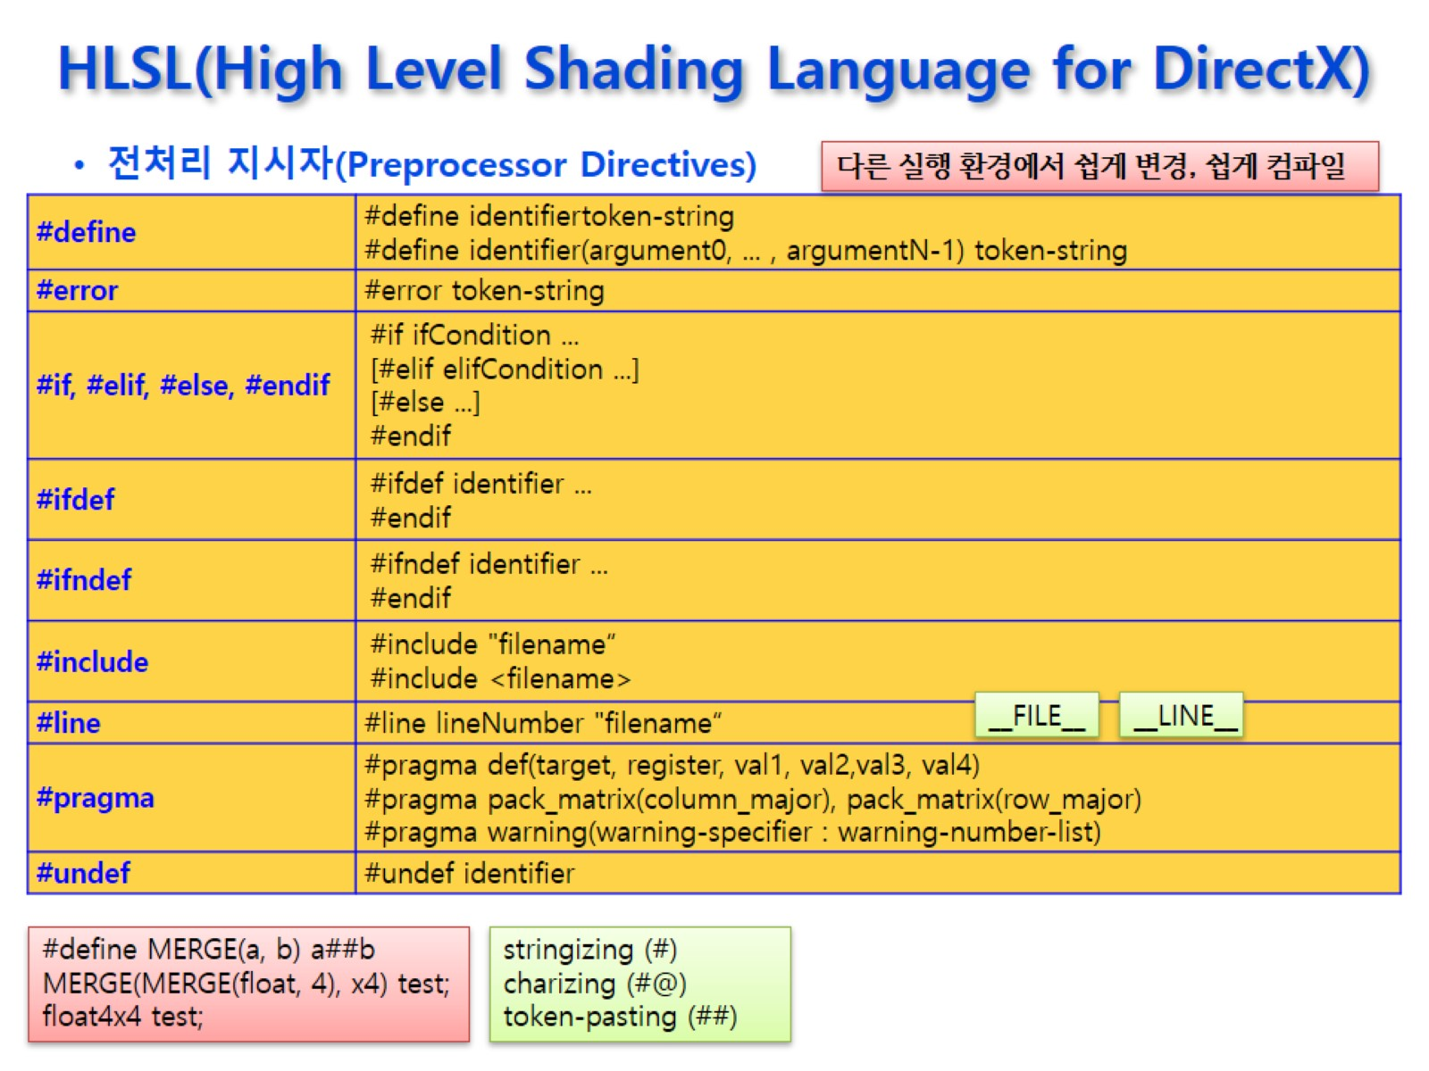
HLSL(High Level Shading Language for DirectX)

Slide 11
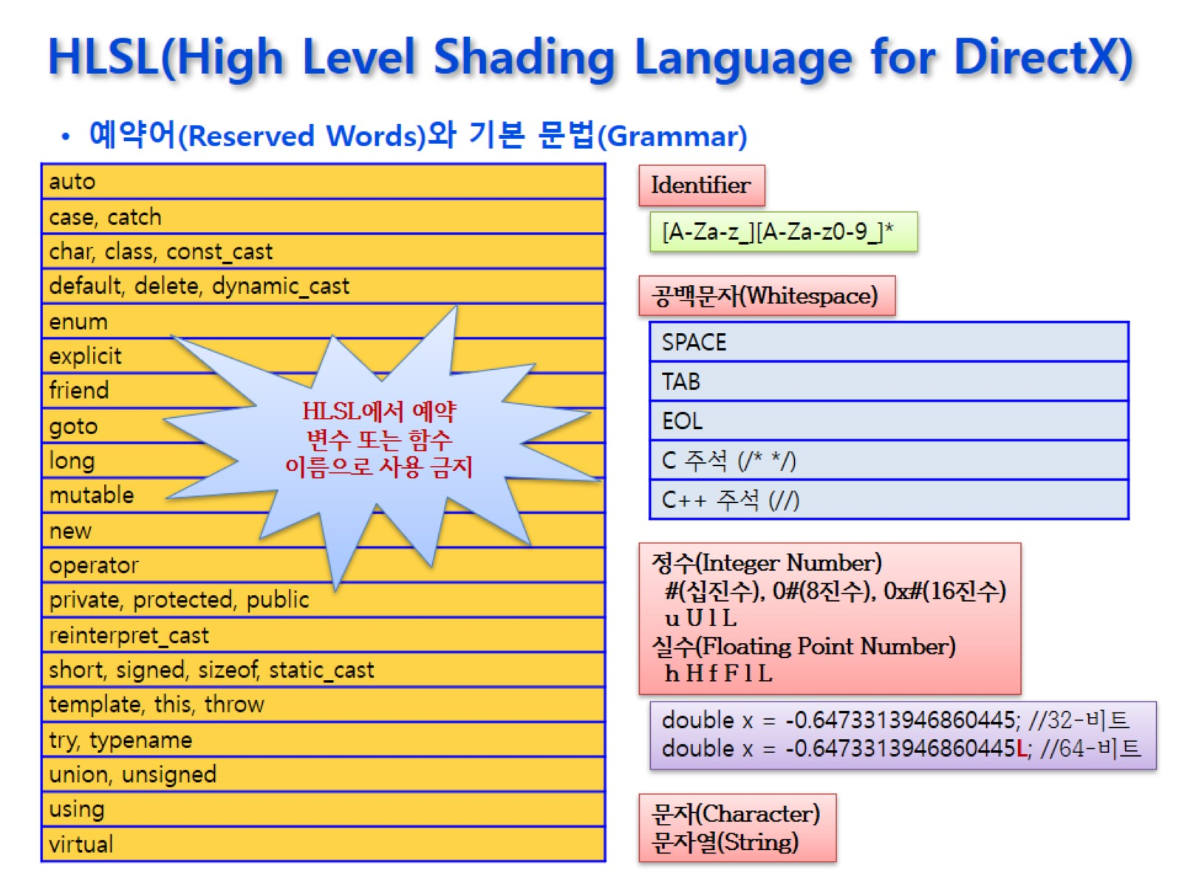
HLSL(High Level Shading Language for DirectX)

Slide 12
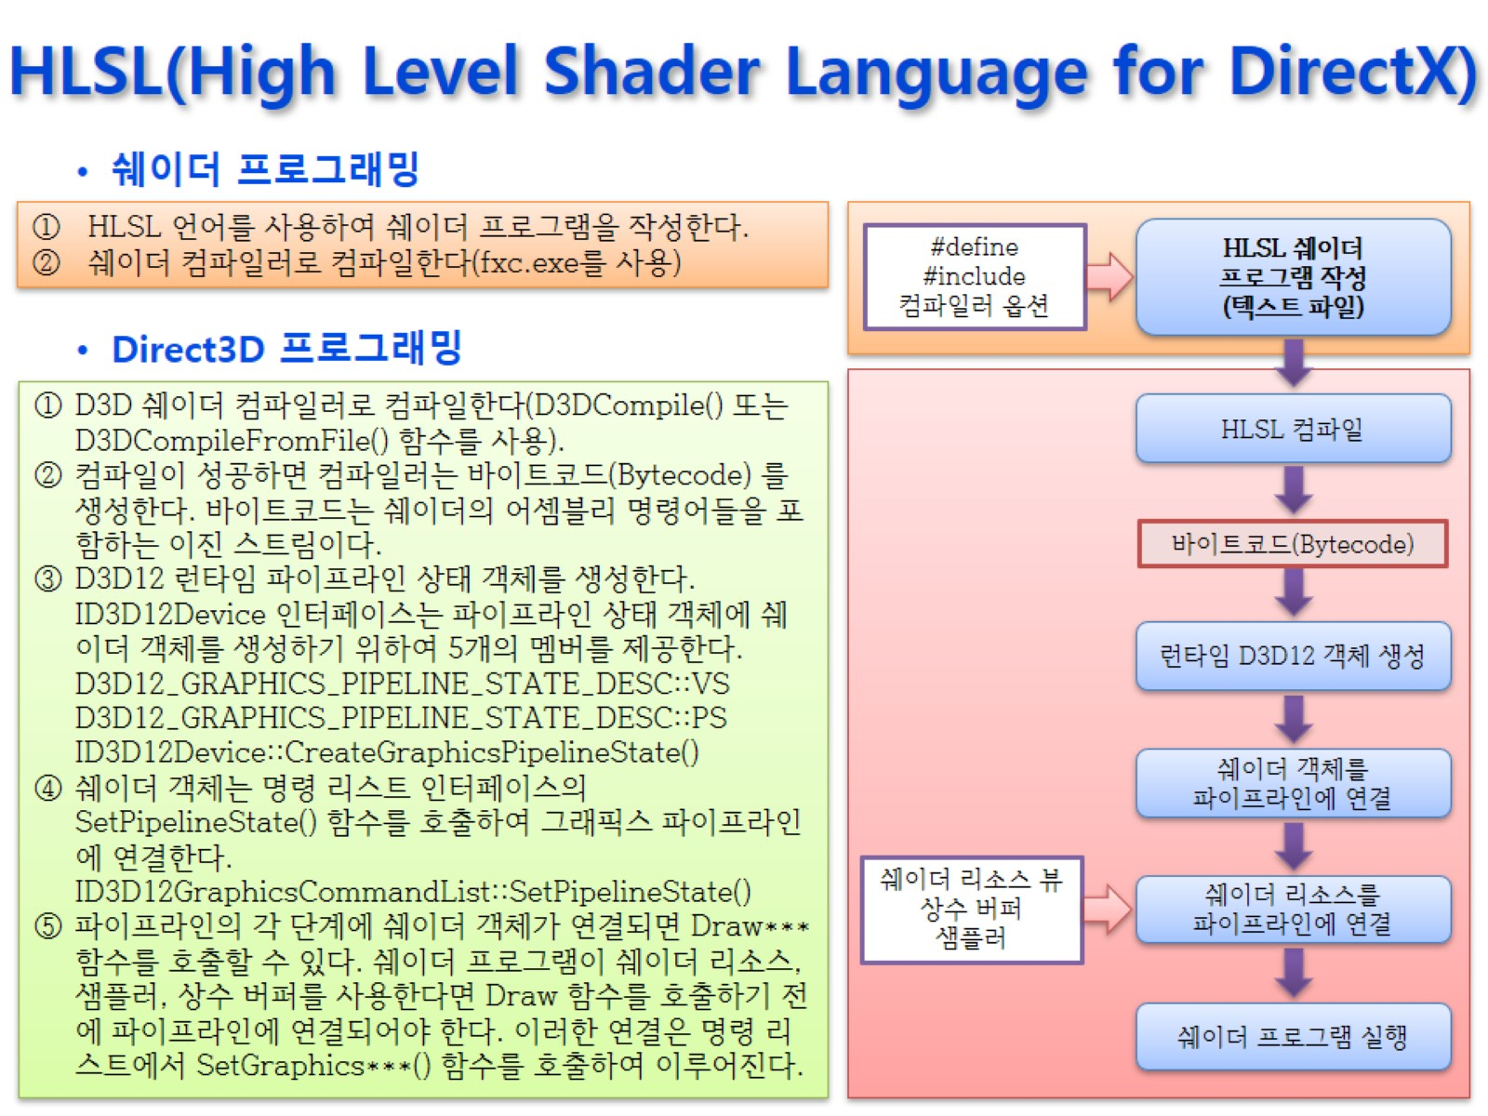
HLSL(High Level Shader Language for DirectX)

Slide 13
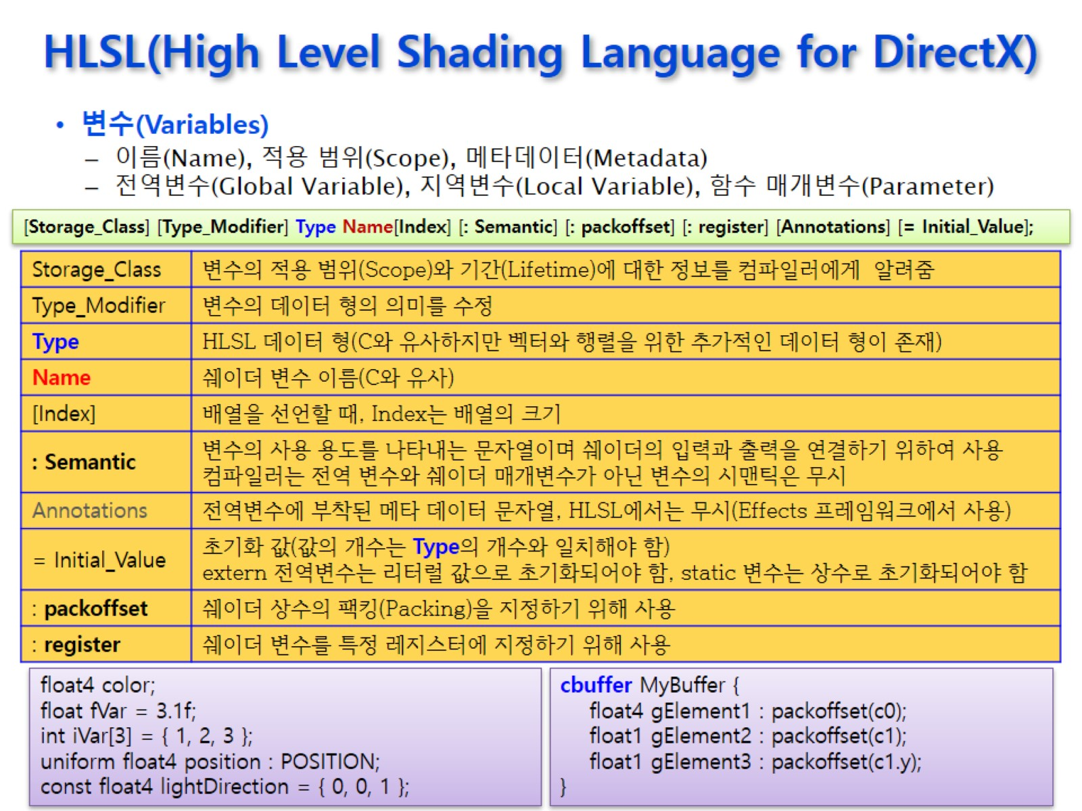


HLSL(High Level Shading Language for DirectX)
C++과 가장 다른 부분
상황에 따라 사용함
Notes:
사용자 정의 변수는 Semantic이 필요 없지만 쉐이더 함수의 매개변수는 필요함

Slide 14
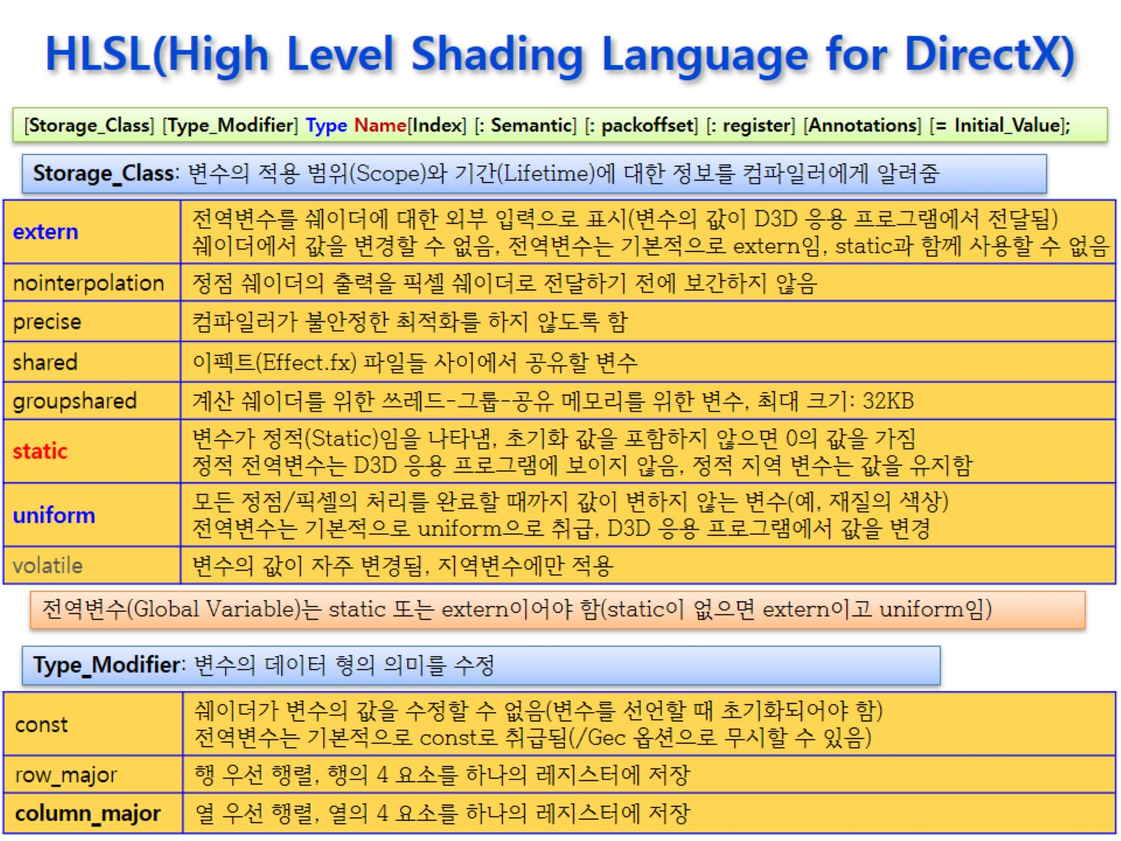



HLSL(High Level Shading Language for DirectX)
Notes:
쉐어더코드에서 모든 전역변수는 default가 extern임

Slide 15
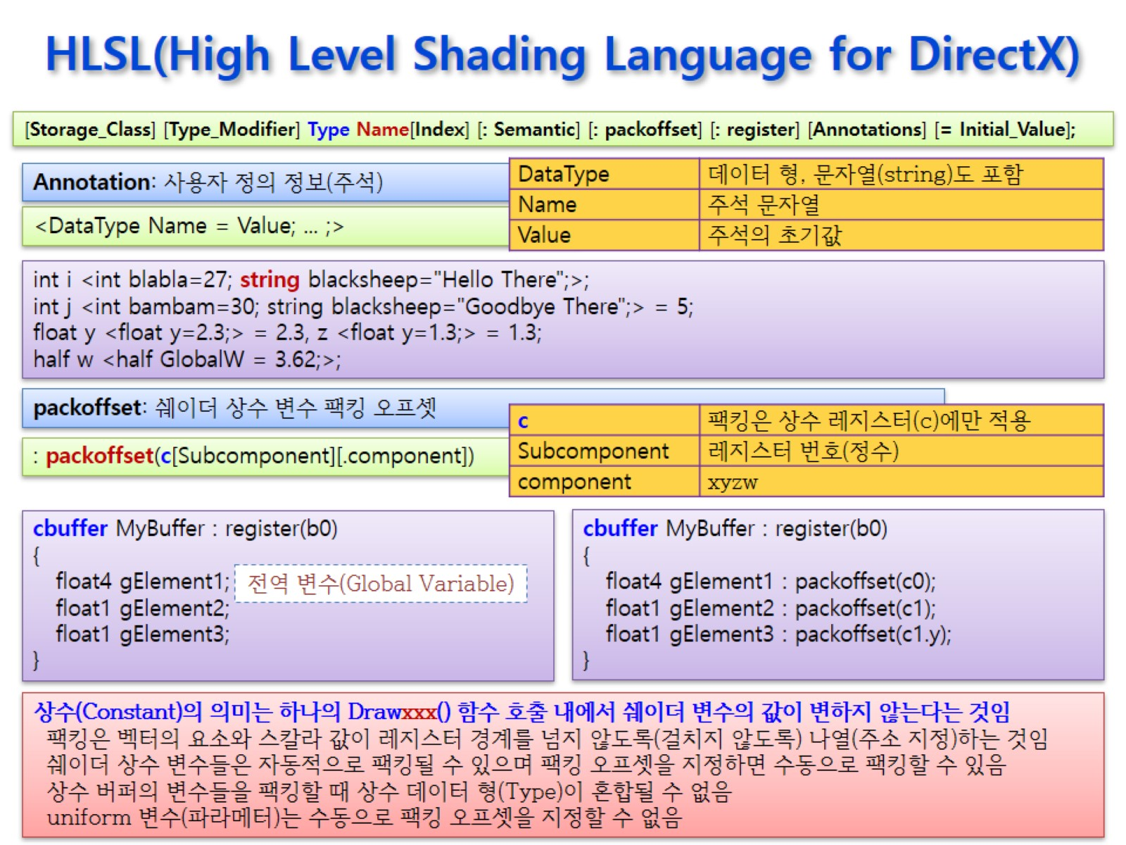


HLSL(High Level Shading Language for DirectX)
Notes:
.component : .x, .y, .z, .w
상수버퍼는 4096개의 벡터 저장 가능
packoffset → register 내의 주소 지정을 위해 사용
안쓰면 컴파일러가 알아서 순서대로 채움
변수 하나당 다른 register의 주소에 접근할 수 없음
ex) c1.z, c1.w, c2.x, c2.y → 불가능

Slide 16
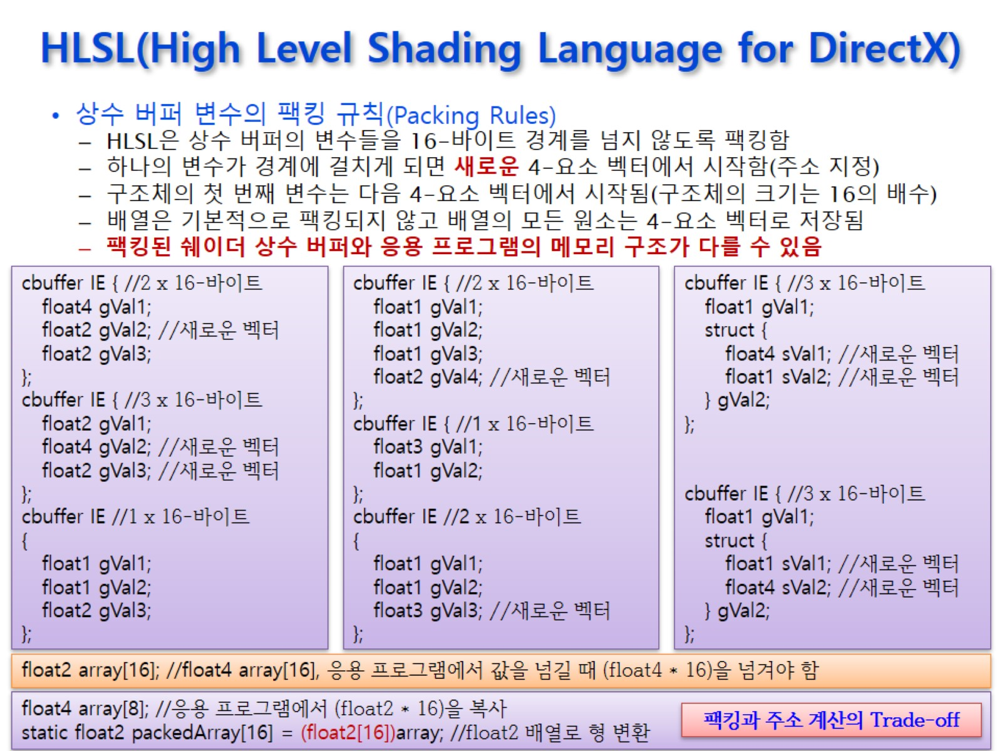
HLSL(High Level Shading Language for DirectX)
Notes:
RootSignature로 값을 쓸 때, 비어있는 공간은 무시해야 한다. (or 더미 데이터 삽입)
구조와 매핑이 같게끔 만들어야 함

Slide 17
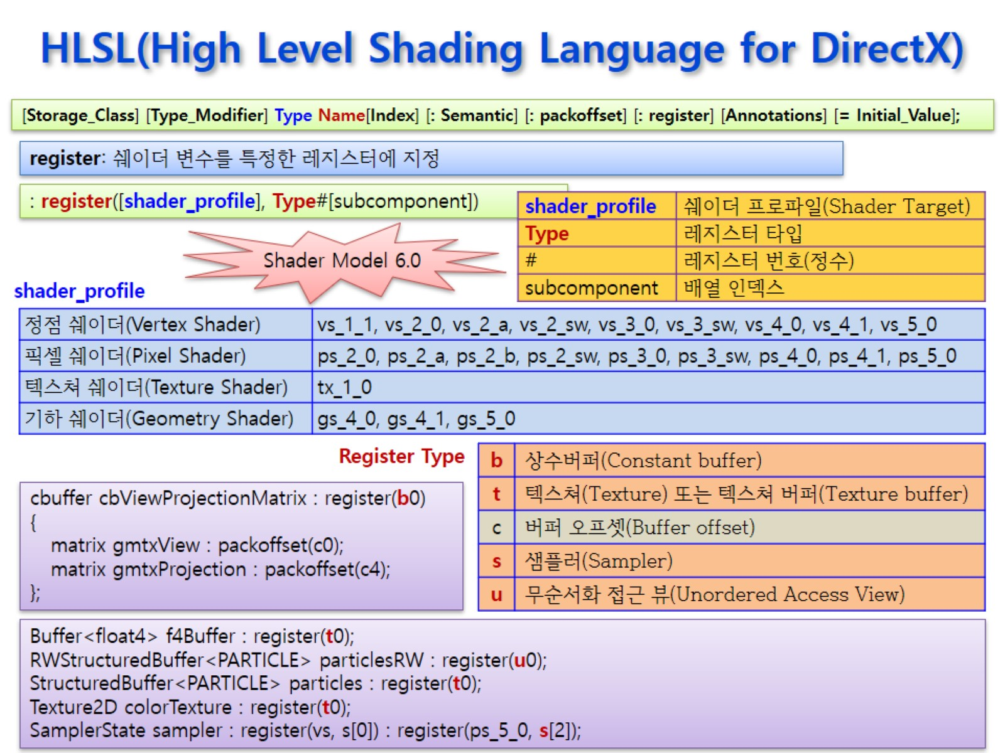

HLSL(High Level Shading Language for DirectX)
Notes:
각 버퍼에는 4096개의 버퍼 저장 가능( c0, c1, c2, … )

Slide 18
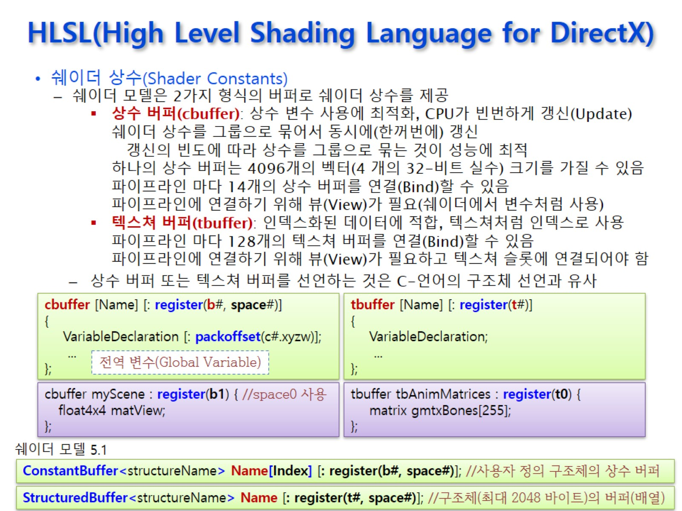


HLSL(High Level Shading Language for DirectX)
Notes:
상수 버퍼 : float4로 제약이 있지만 굉장히 빠른 속도
ConstantBuffer → structureName을 템플릿처럼 사용 가능

Slide 19
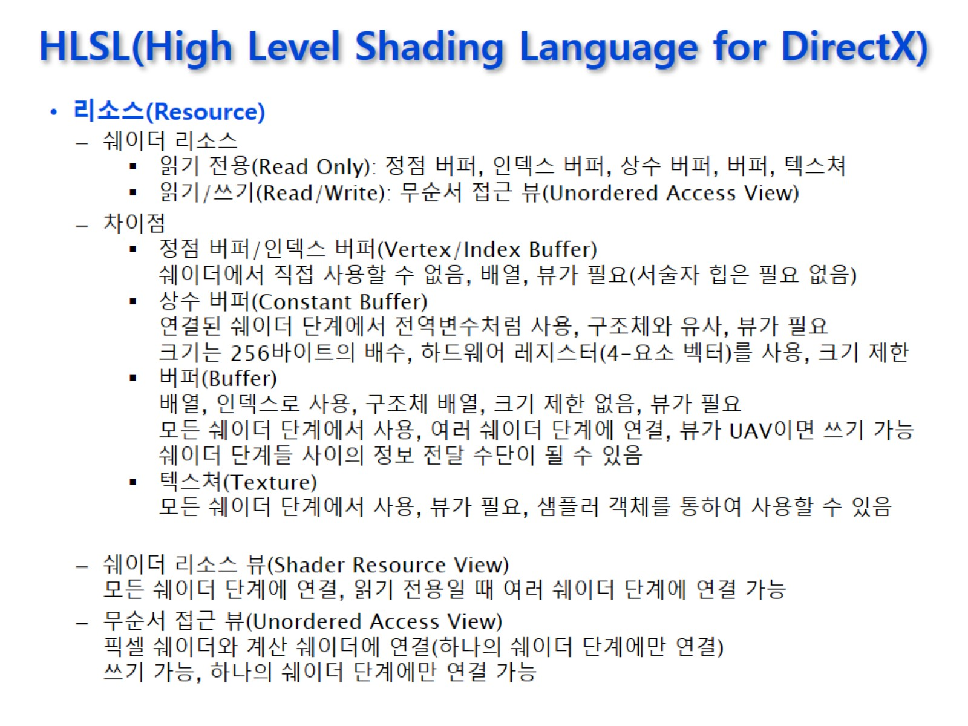
HLSL(High Level Shading Language for DirectX)

Slide 20
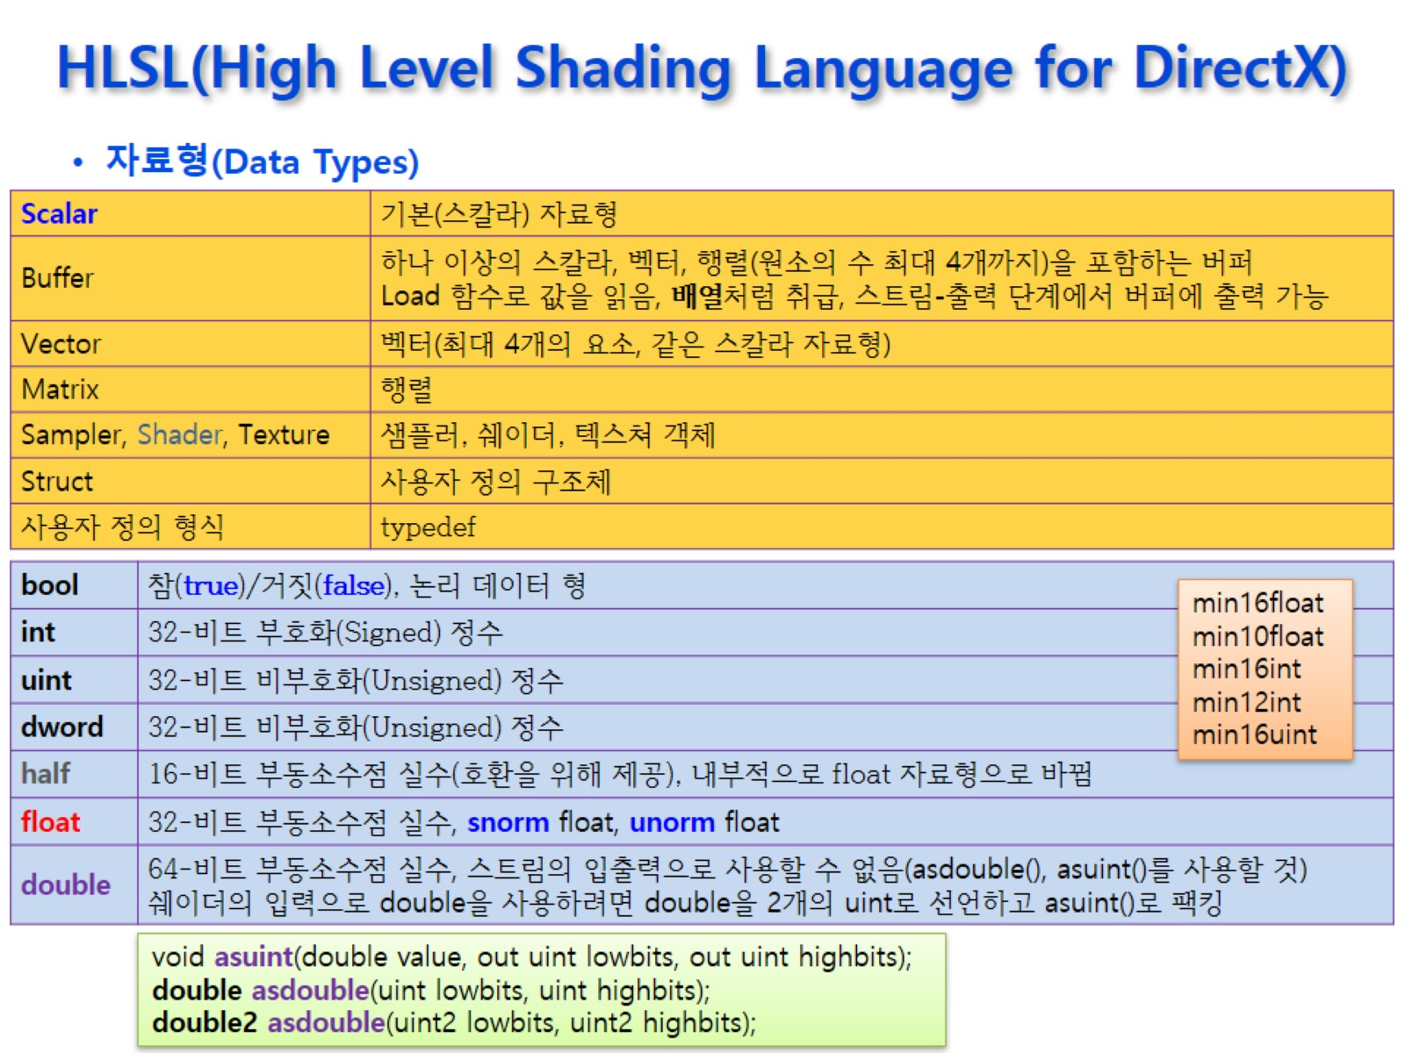
HLSL(High Level Shading Language for DirectX)

Slide 21
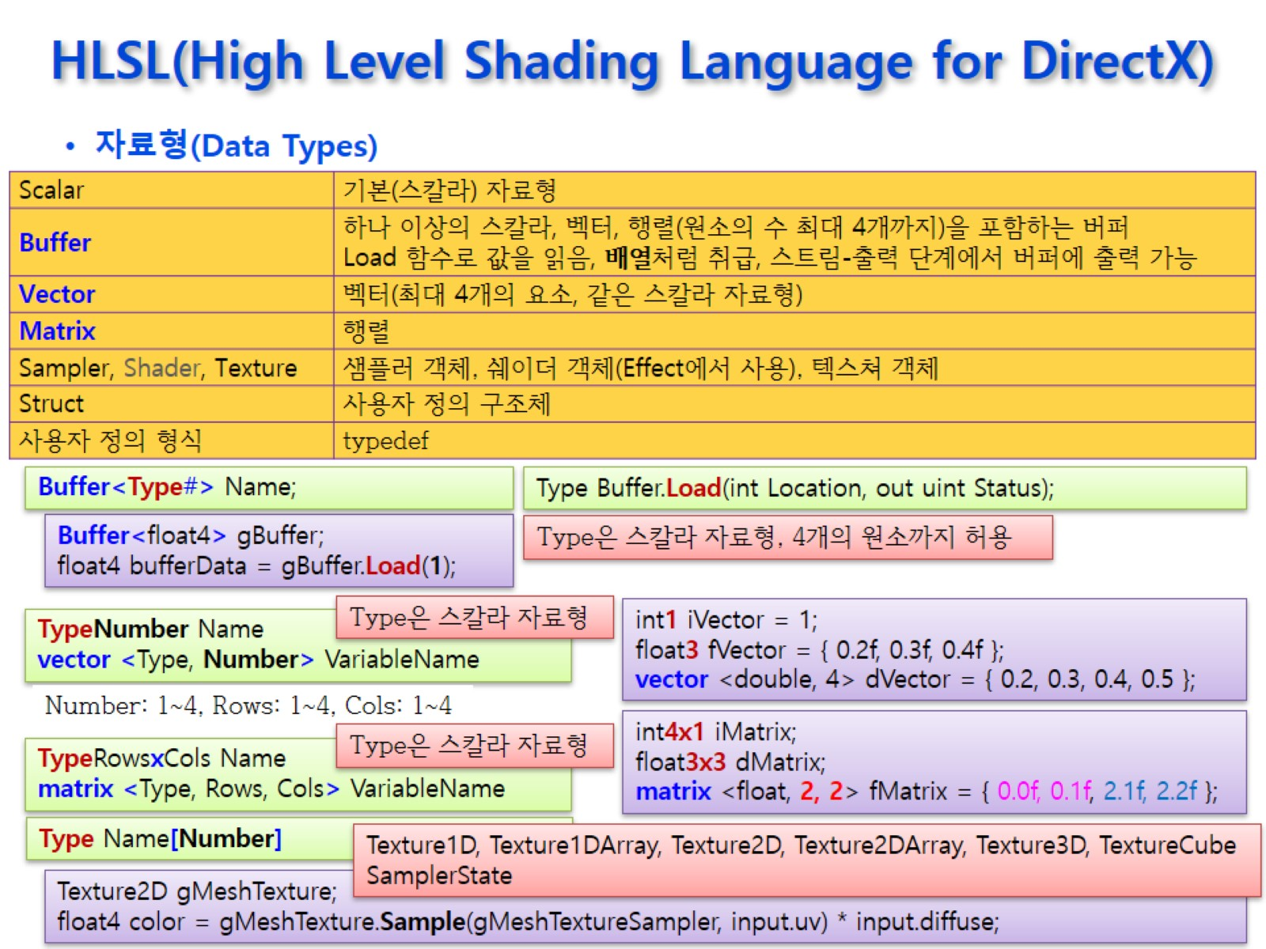
HLSL(High Level Shading Language for DirectX)

Slide 22
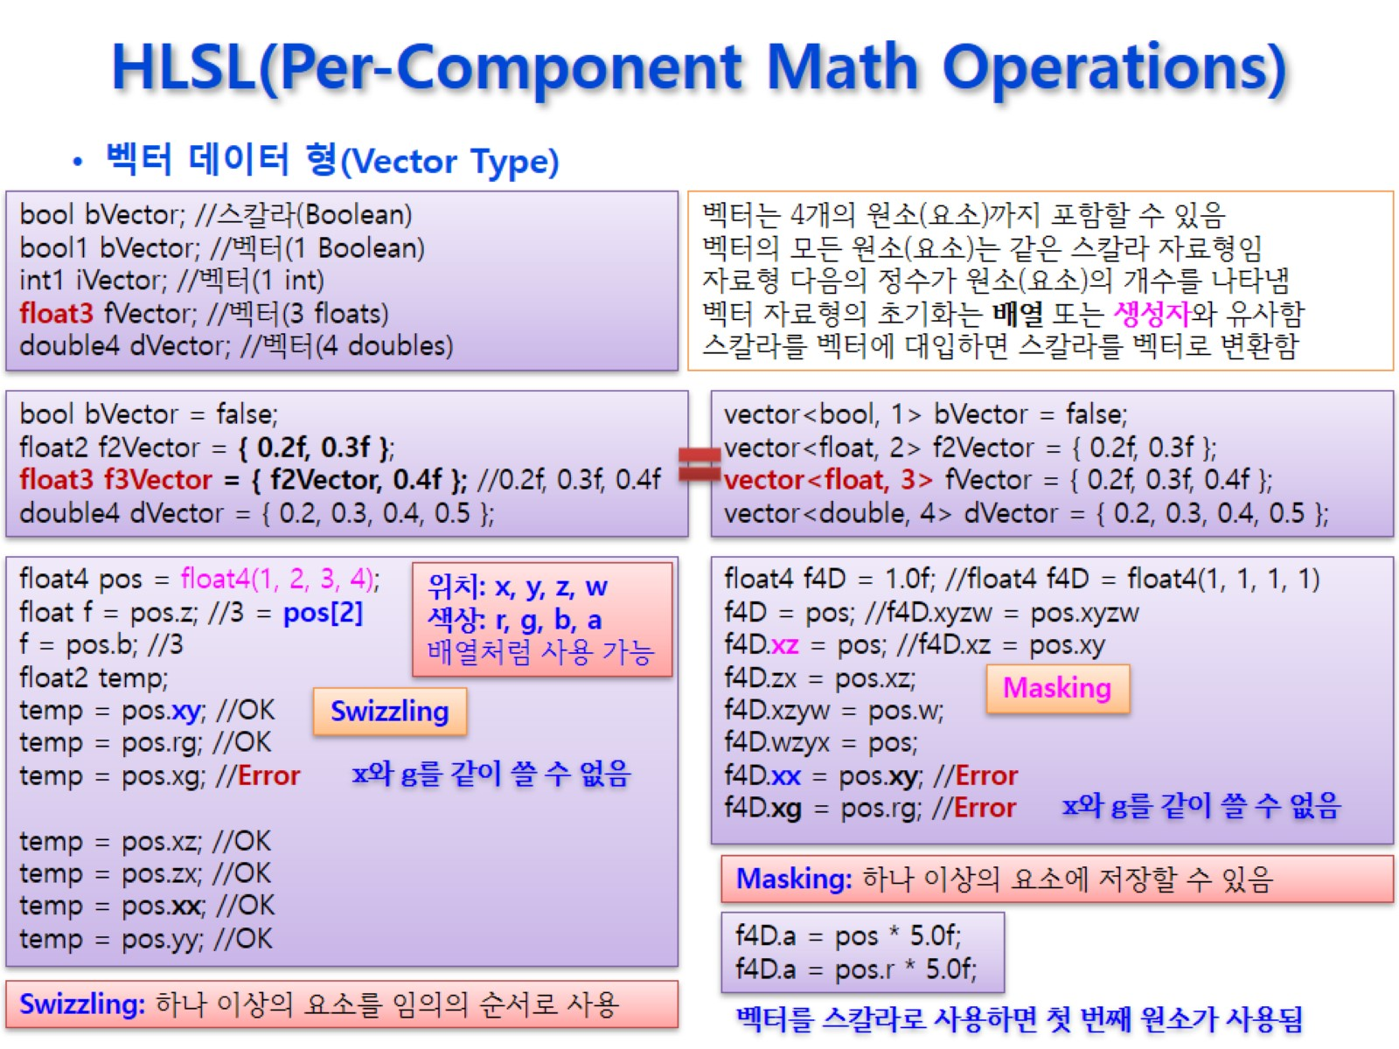
HLSL(Per-Component Math Operations)
Notes:
1.0f → (1,1,1,1) ➔ 혼란의 여지 X -> 좋은 코드

Slide 23
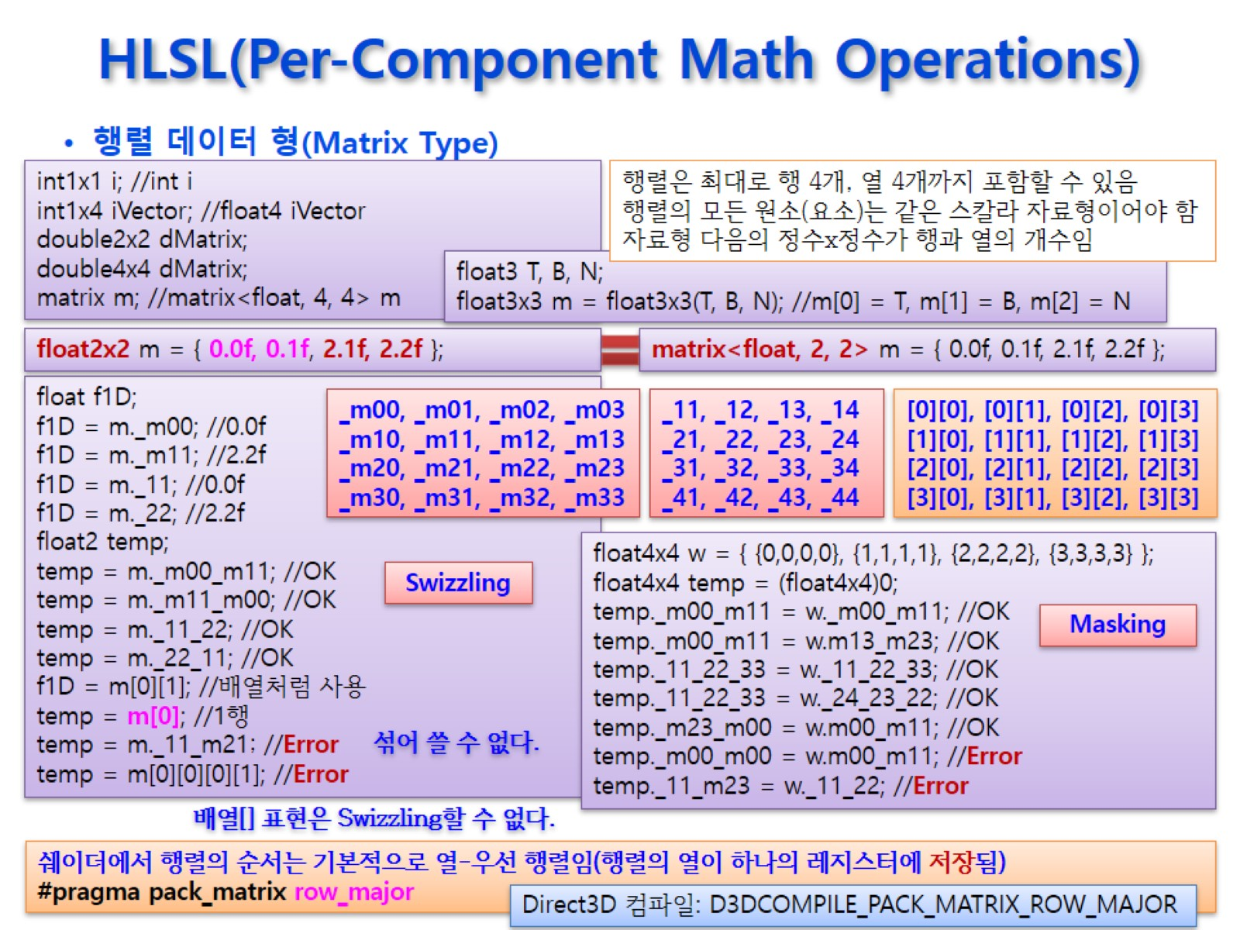
HLSL(Per-Component Math Operations)

Slide 24
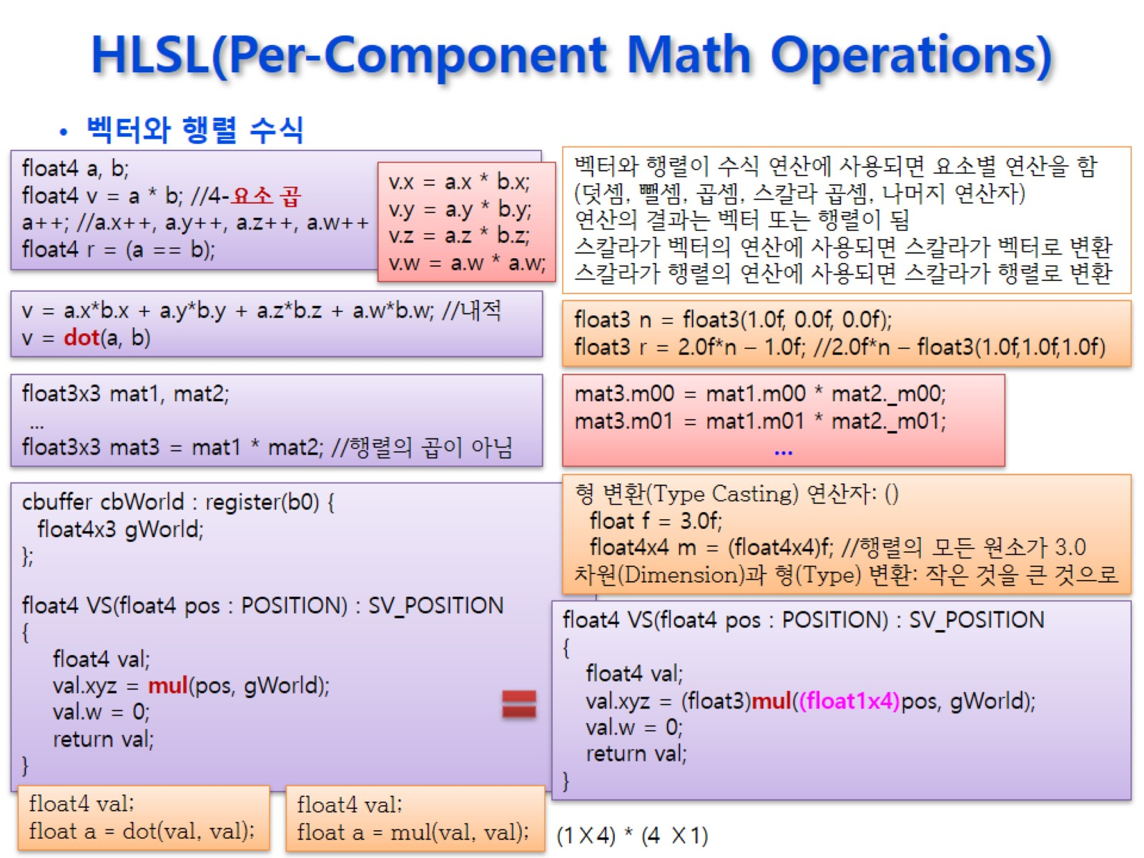
HLSL(Per-Component Math Operations)
Notes:
내적을 하려면, dot함수 사용

Slide 25
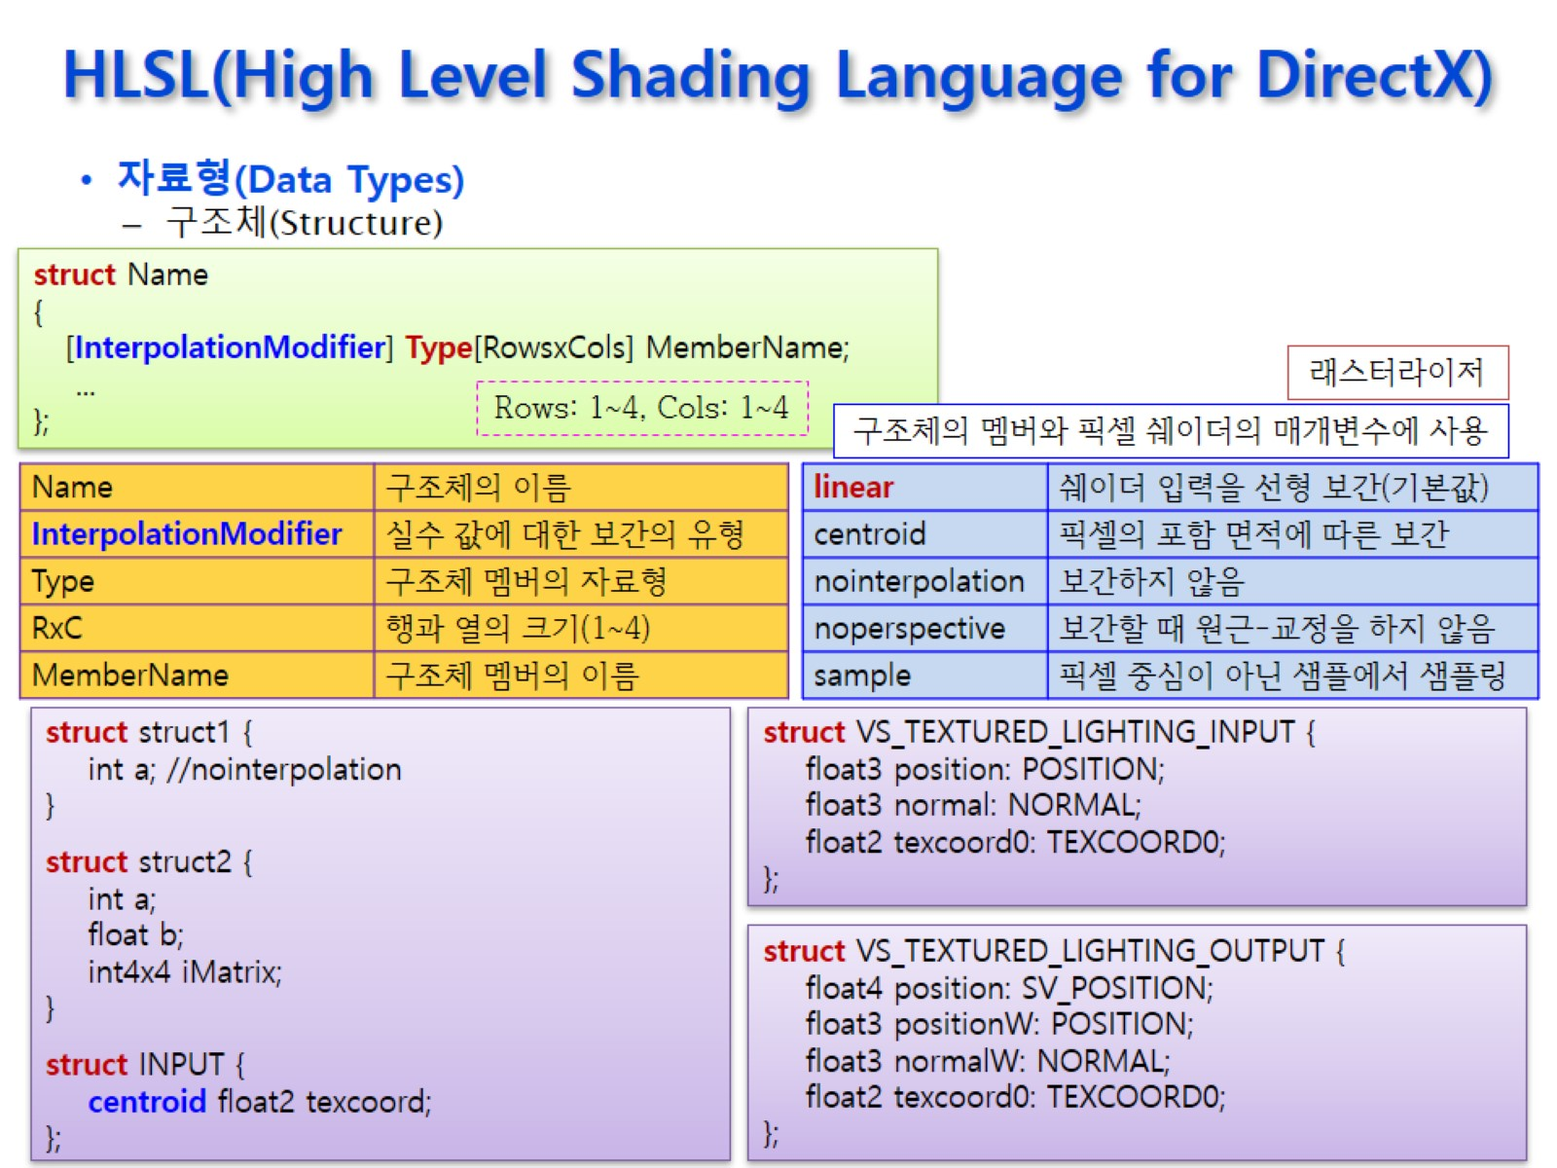
HLSL(High Level Shading Language for DirectX)

Slide 26
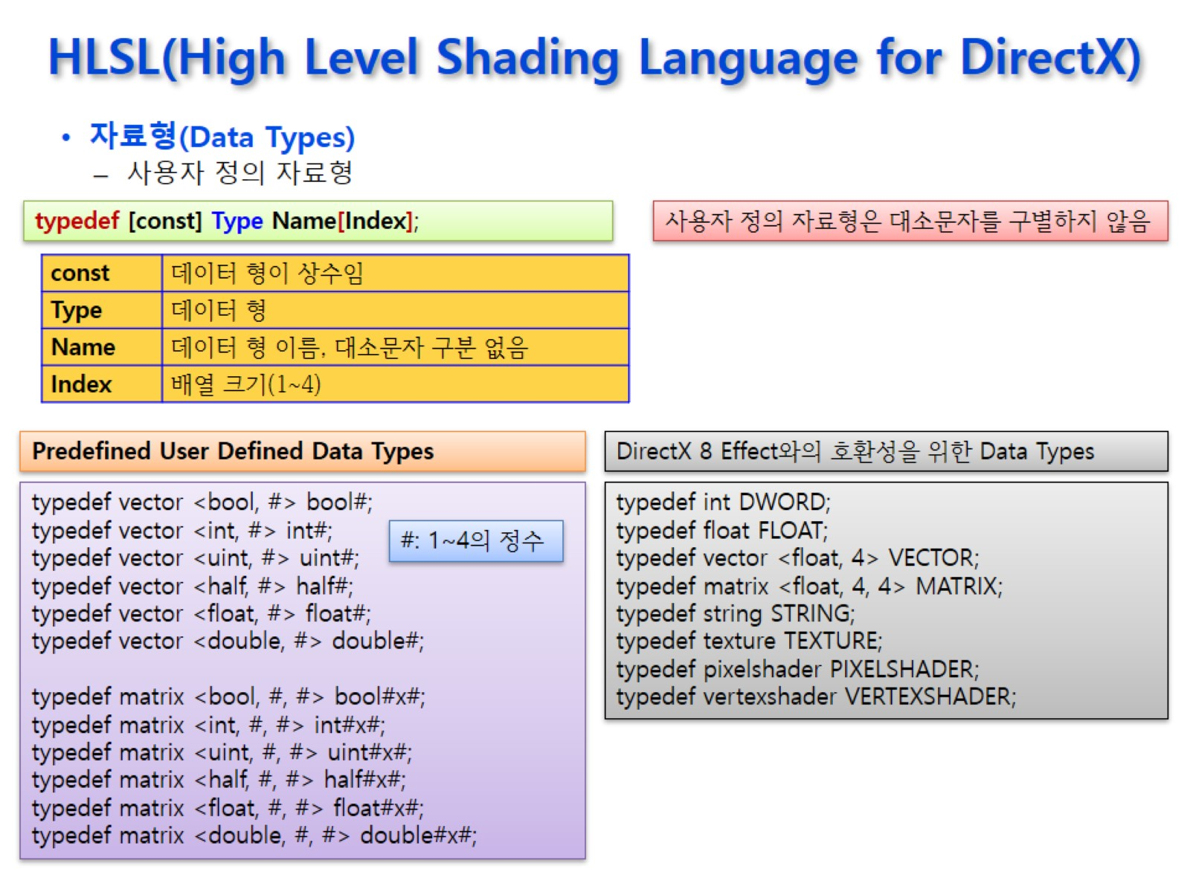
HLSL(High Level Shading Language for DirectX)

Slide 27
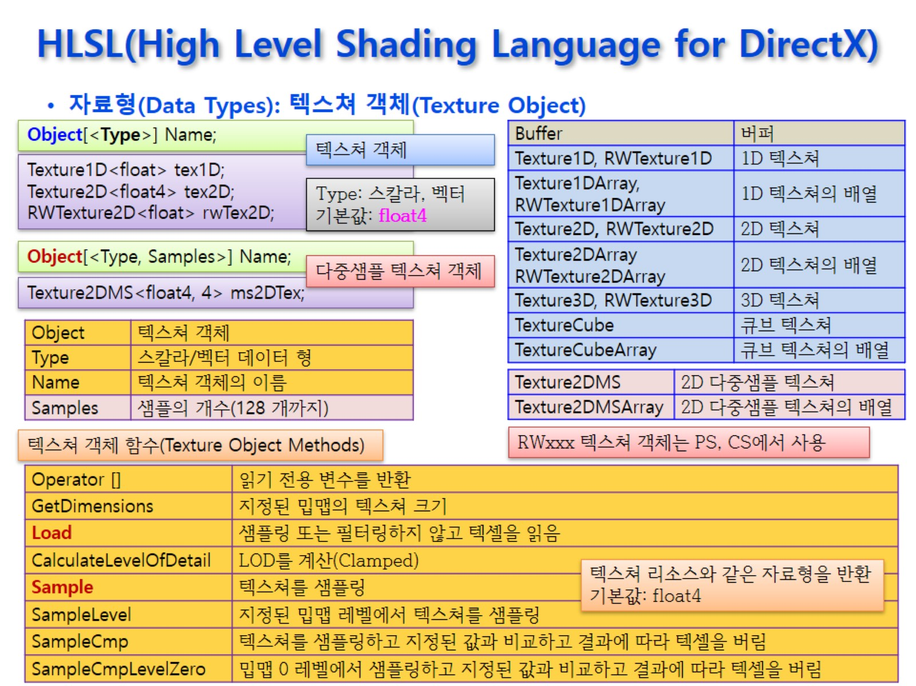
HLSL(High Level Shading Language for DirectX)

Slide 28
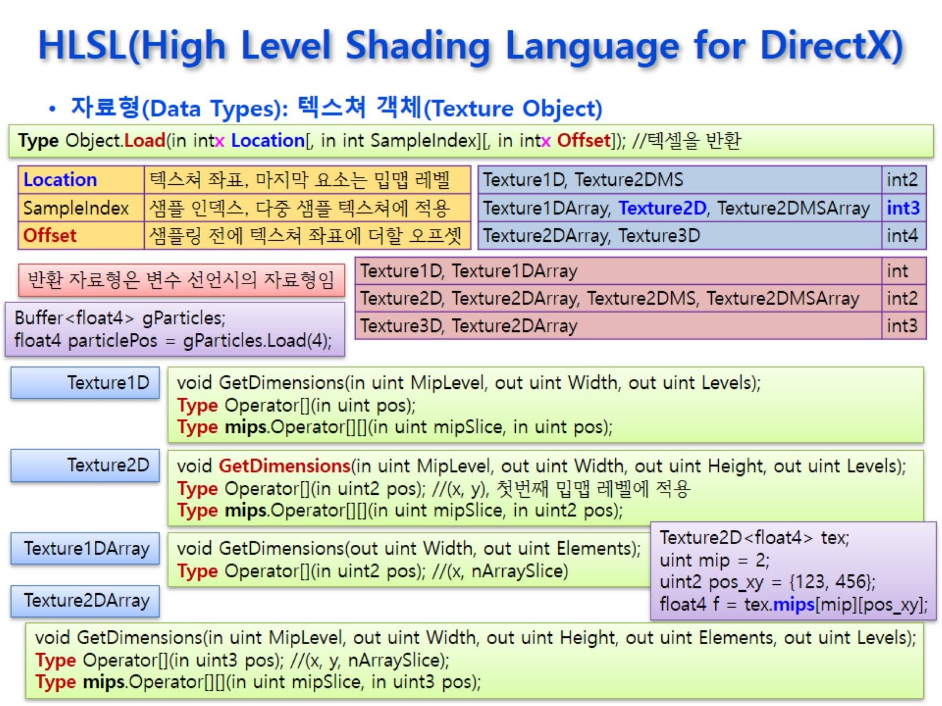
HLSL(High Level Shading Language for DirectX)

Slide 29
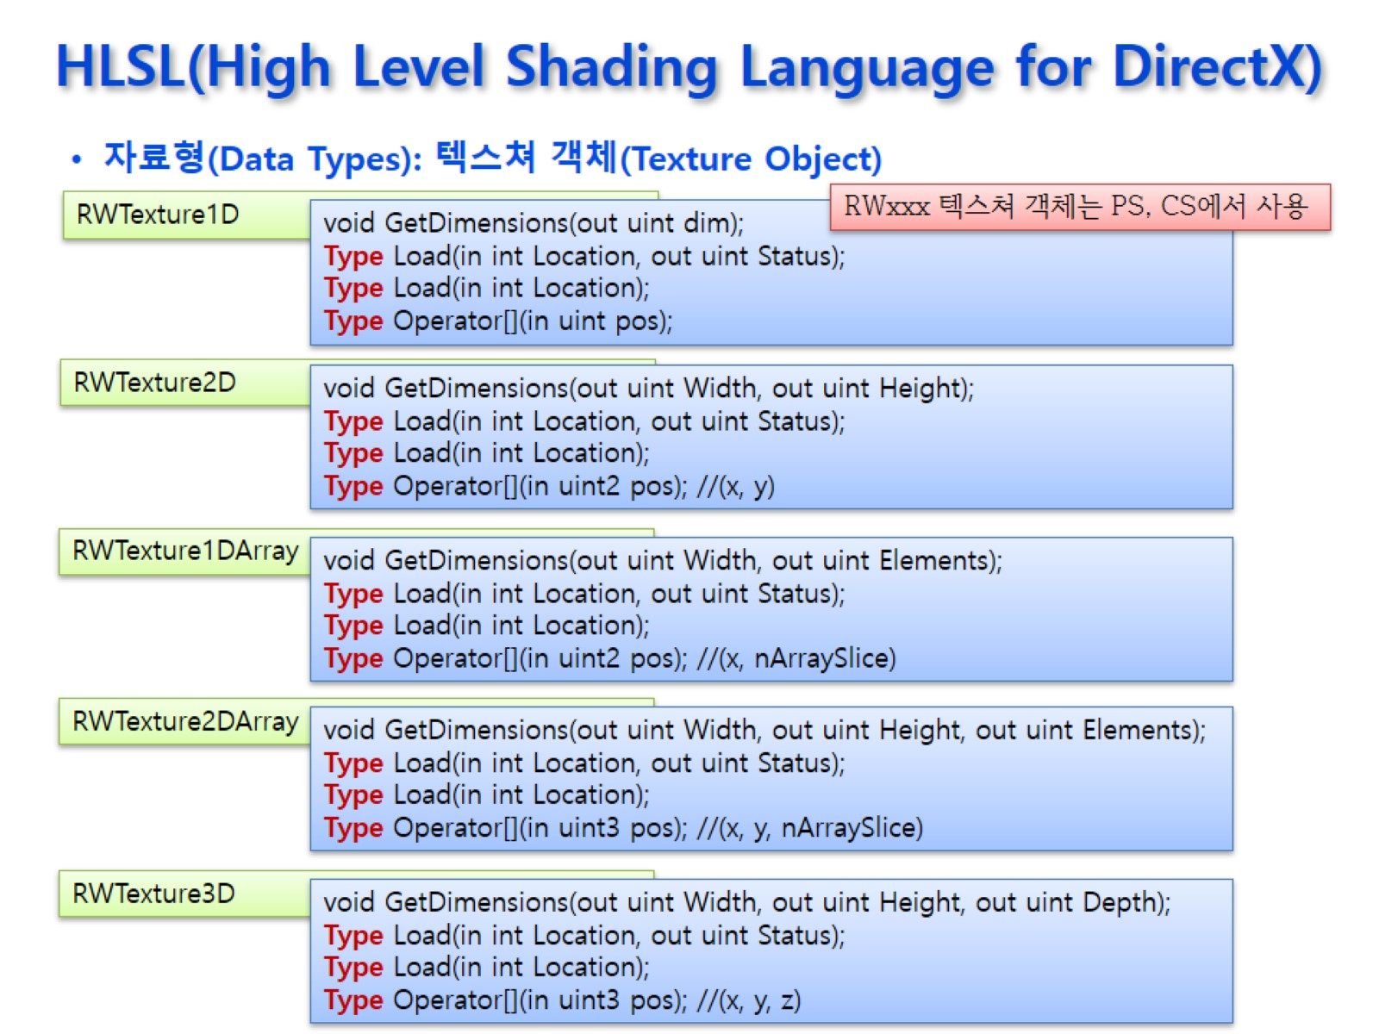
HLSL(High Level Shading Language for DirectX)

Slide 30
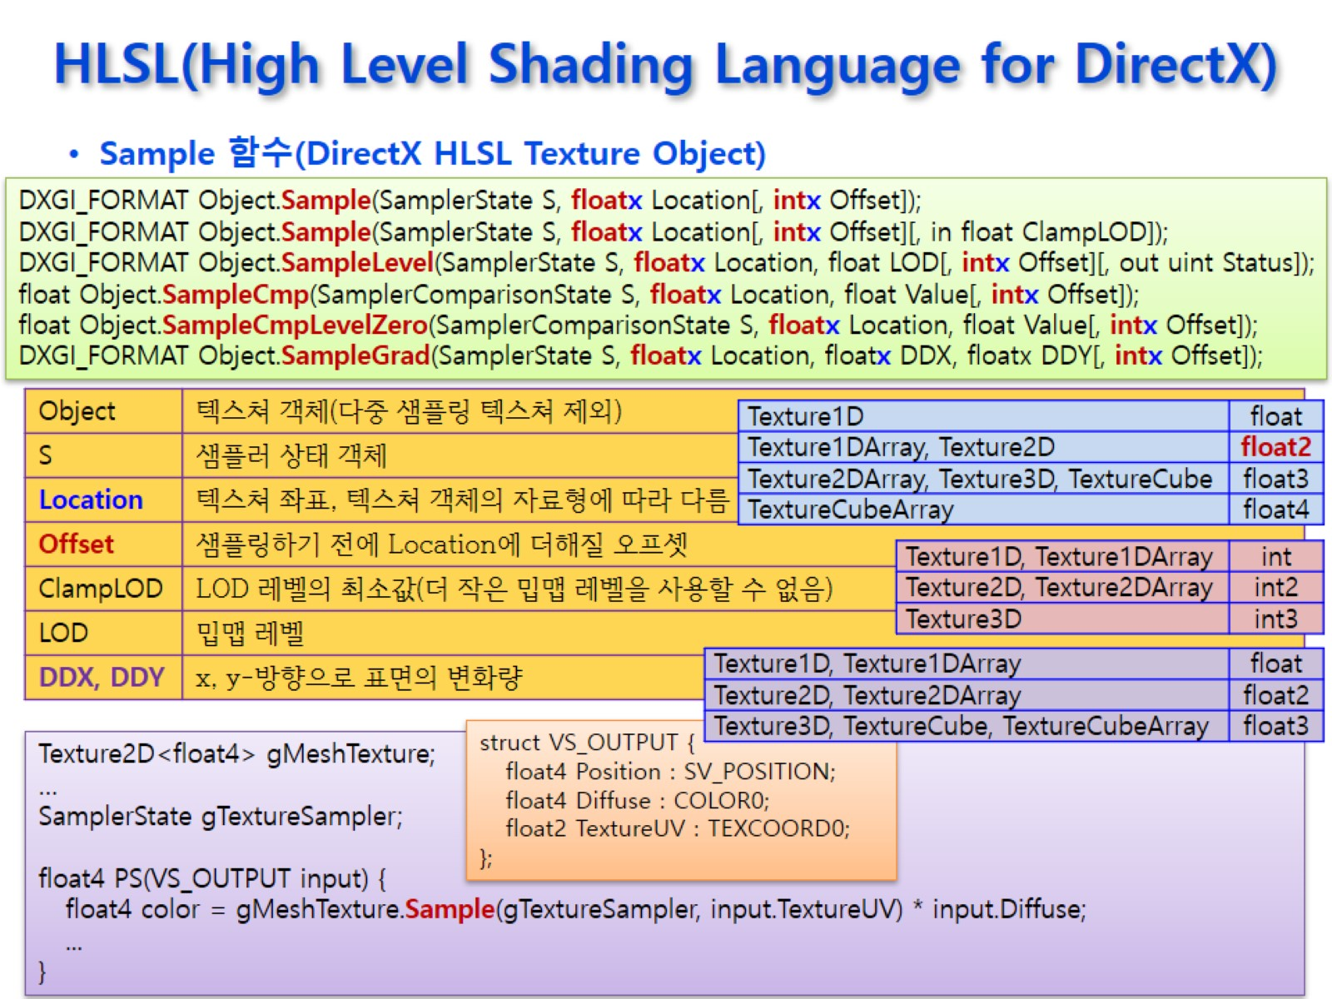
HLSL(High Level Shading Language for DirectX)

Slide 31
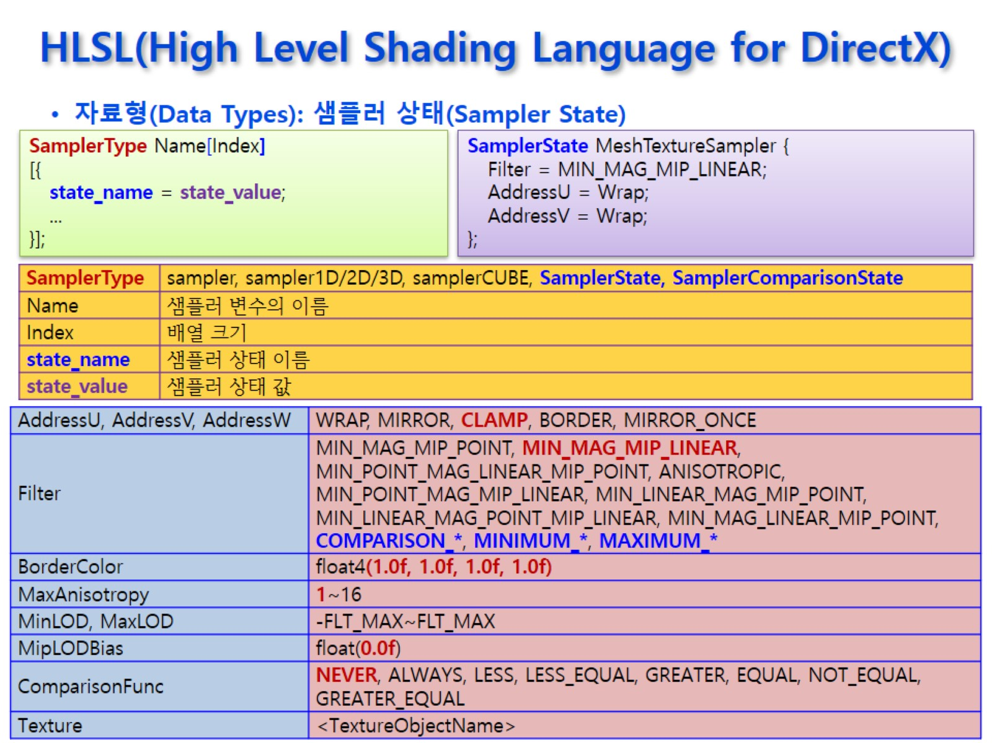
HLSL(High Level Shading Language for DirectX)

Slide 32
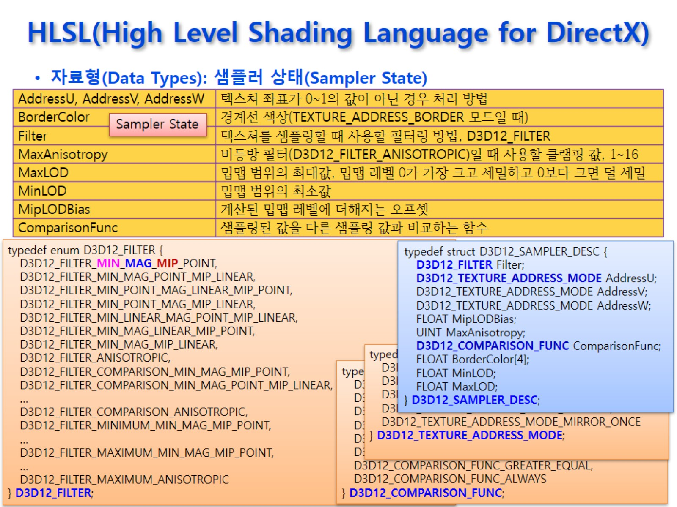
HLSL(High Level Shading Language for DirectX)

Slide 33
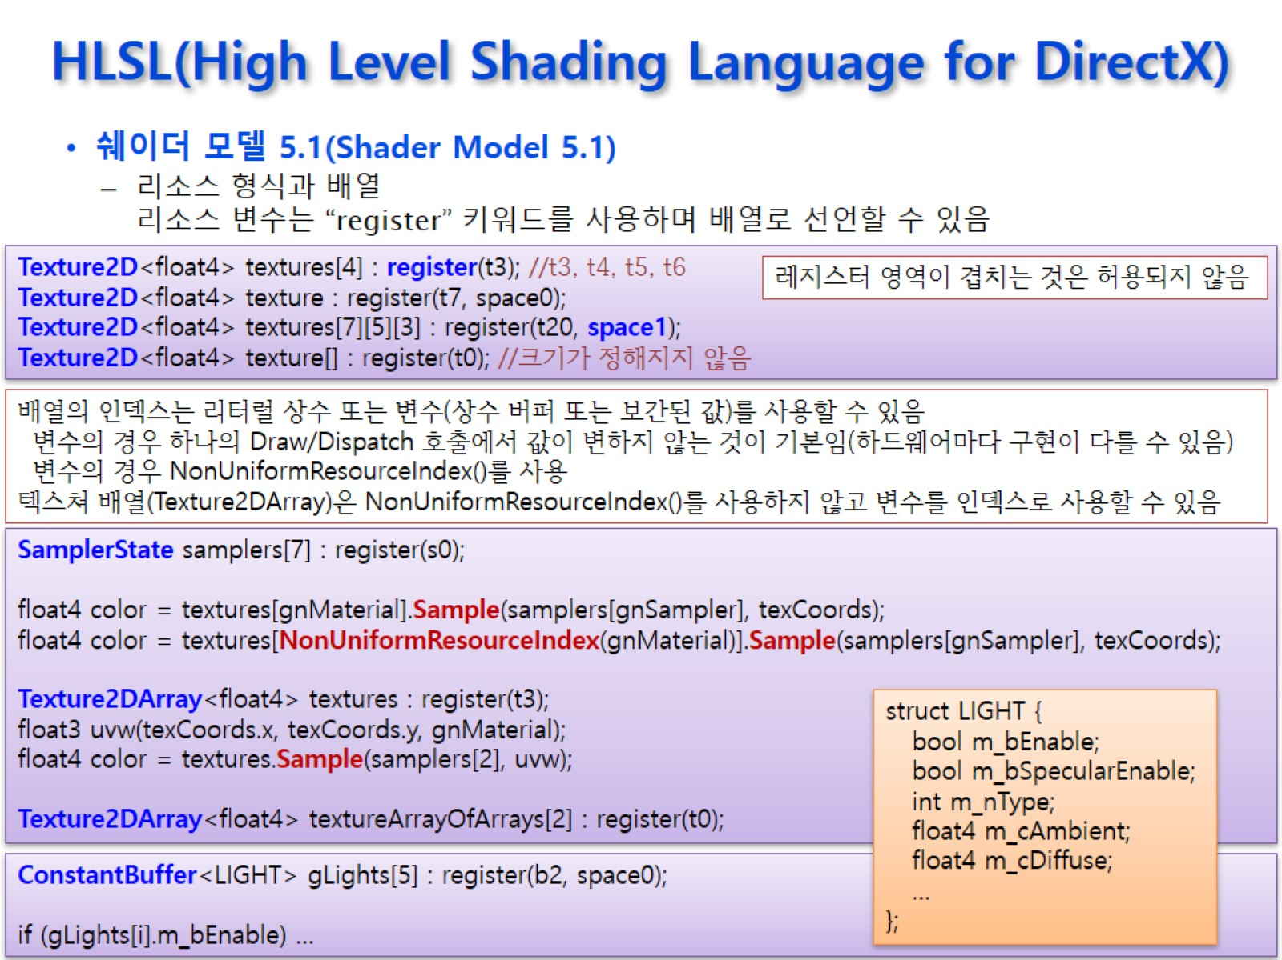
HLSL(High Level Shading Language for DirectX)

Slide 34
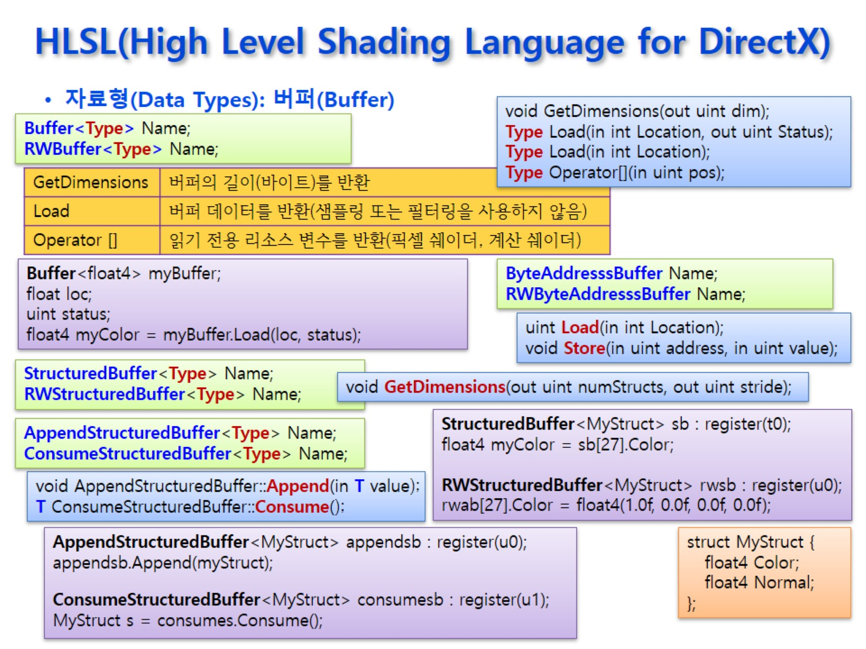
HLSL(High Level Shading Language for DirectX)

Slide 35
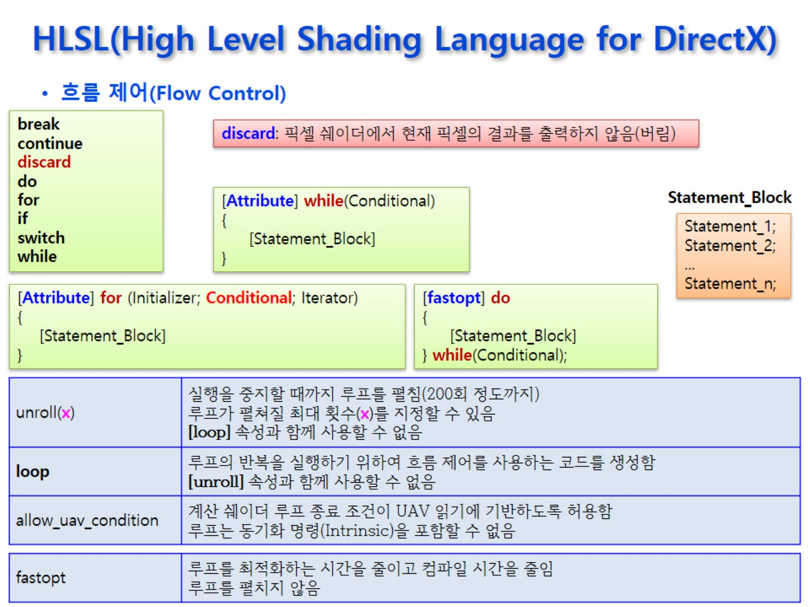
HLSL(High Level Shading Language for DirectX)

Slide 36
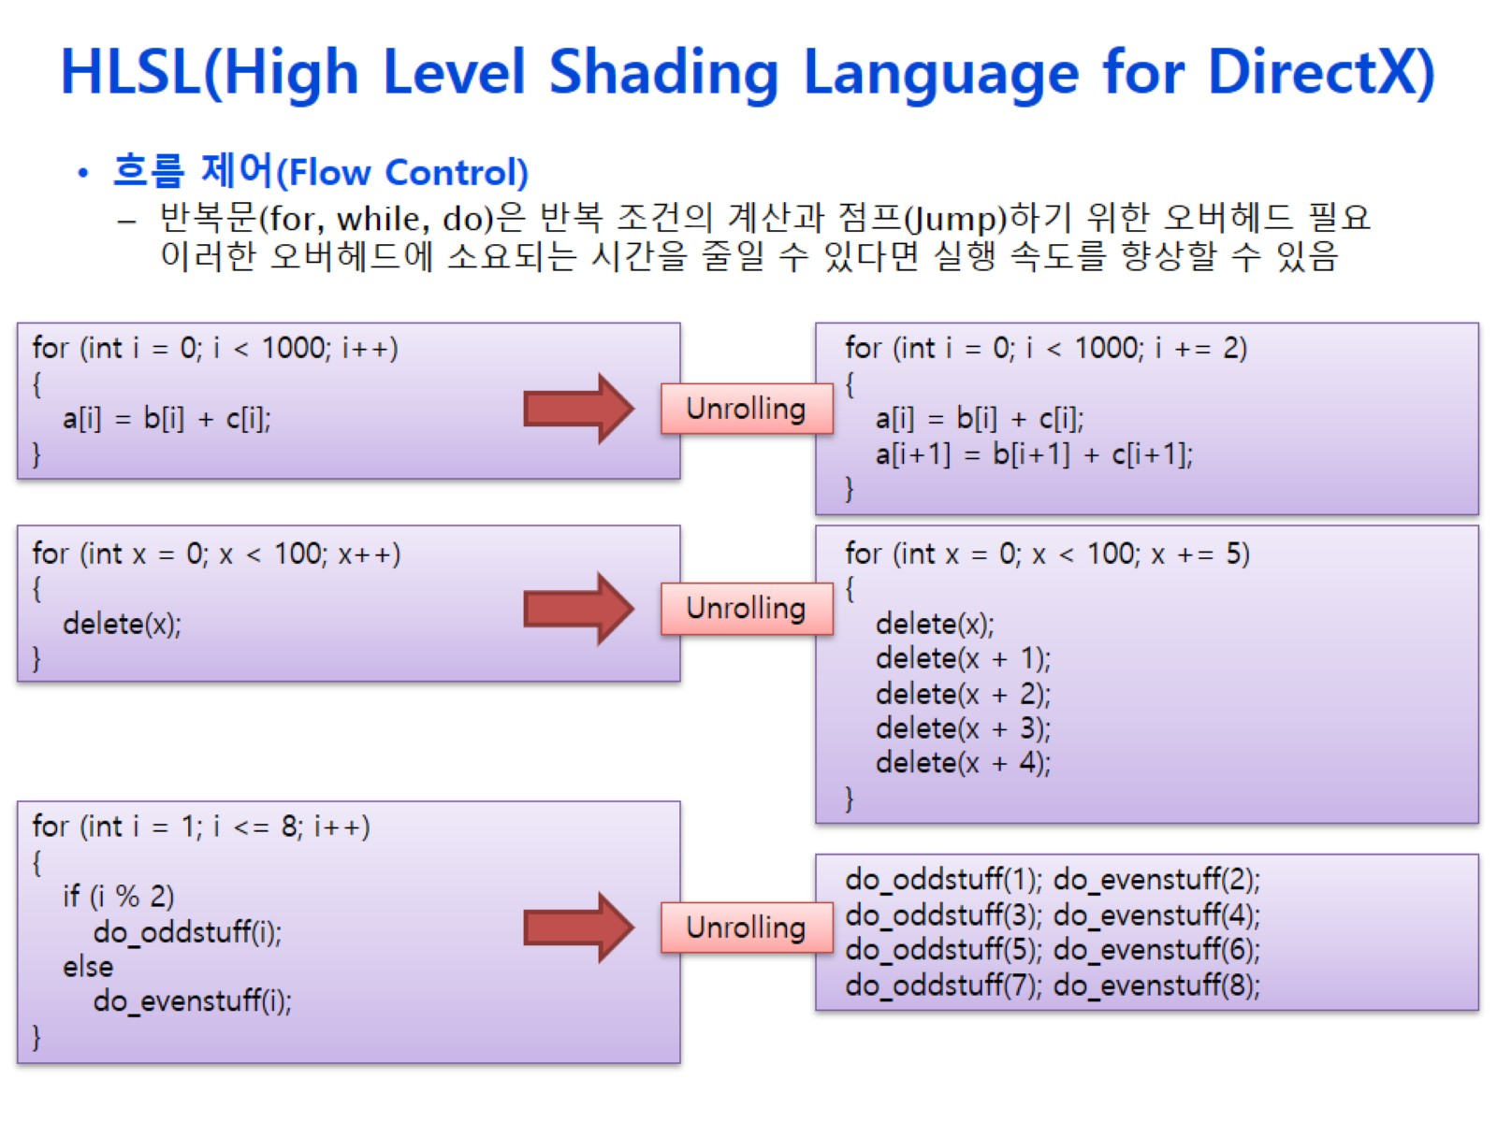
HLSL(High Level Shading Language for DirectX)

Slide 37
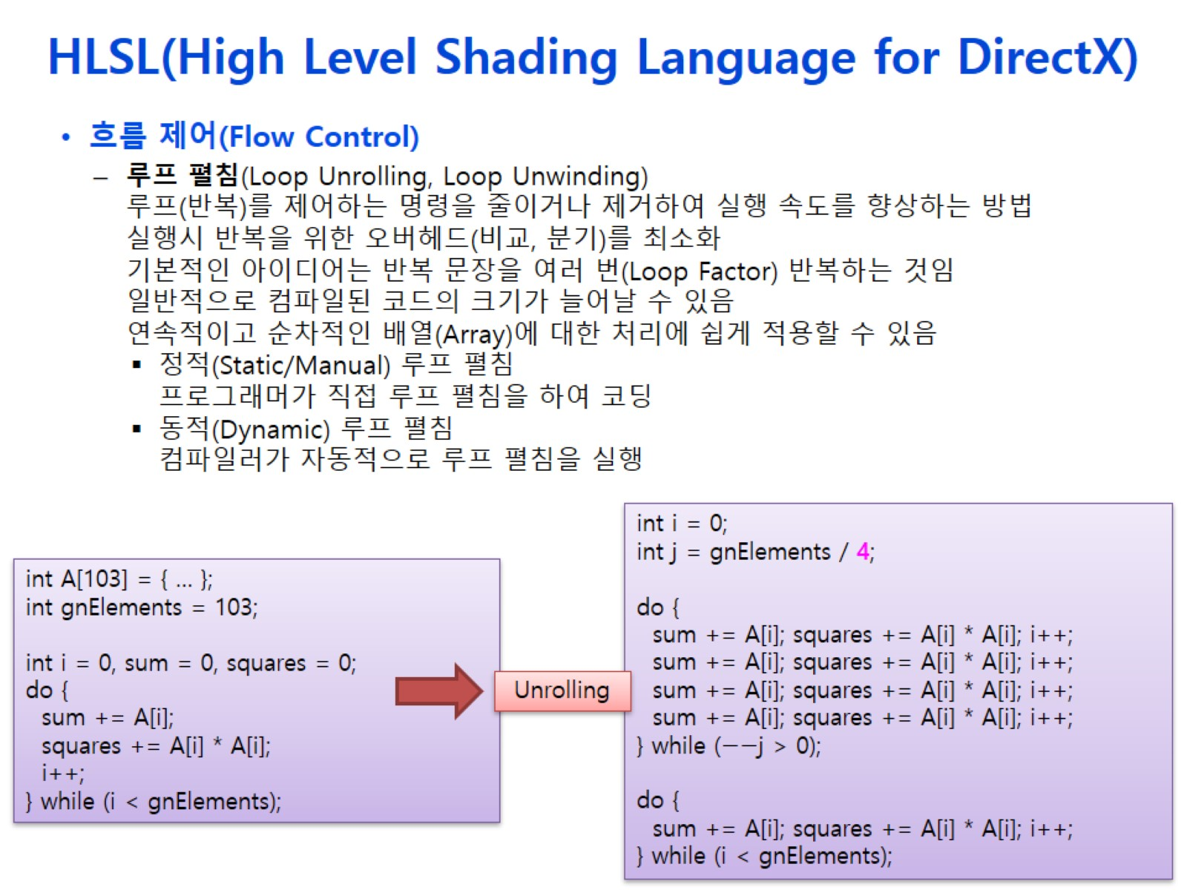
HLSL(High Level Shading Language for DirectX)

Slide 38
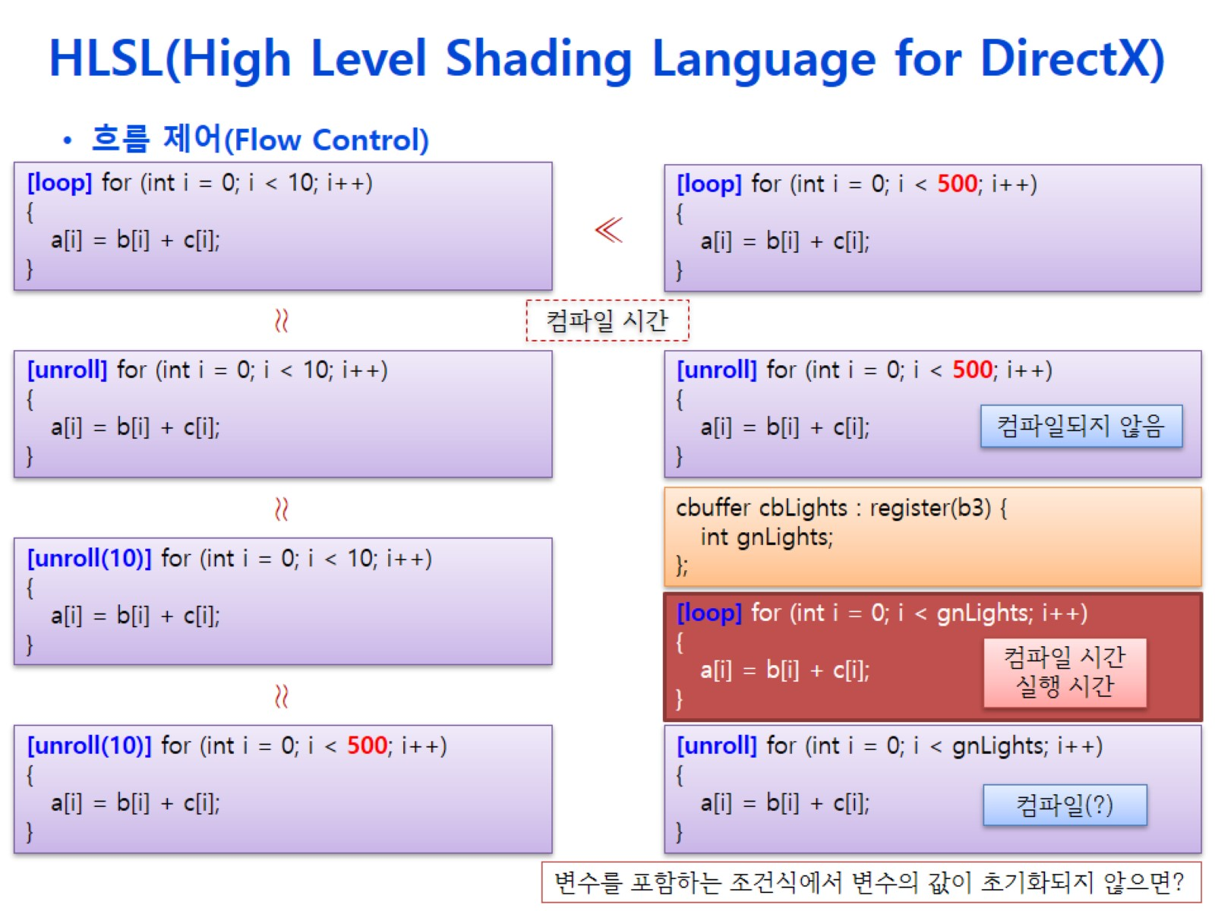
HLSL(High Level Shading Language for DirectX)

Slide 39
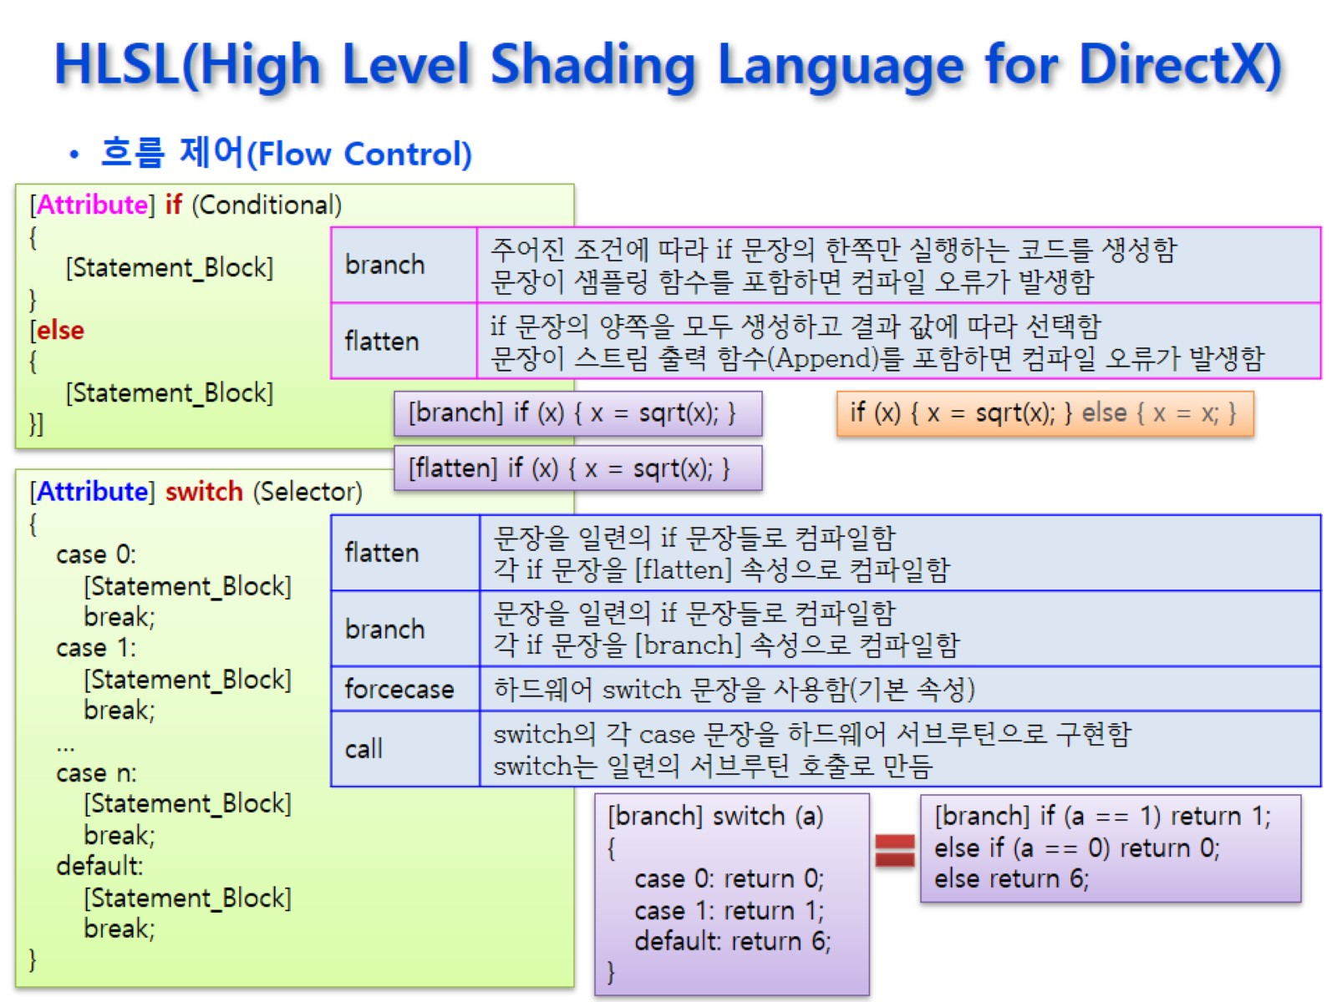
HLSL(High Level Shading Language for DirectX)

Slide 40
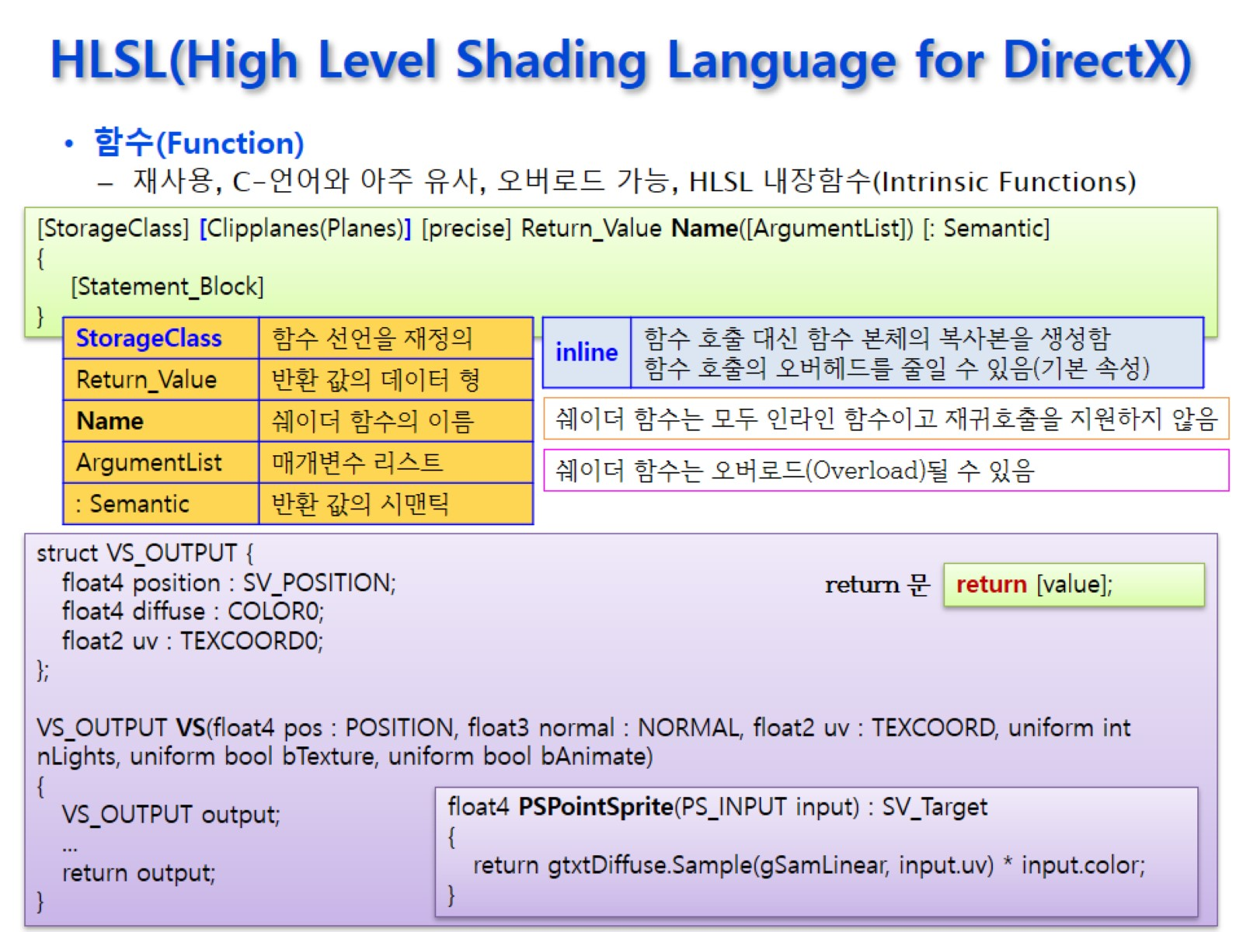
HLSL(High Level Shading Language for DirectX)

Slide 41
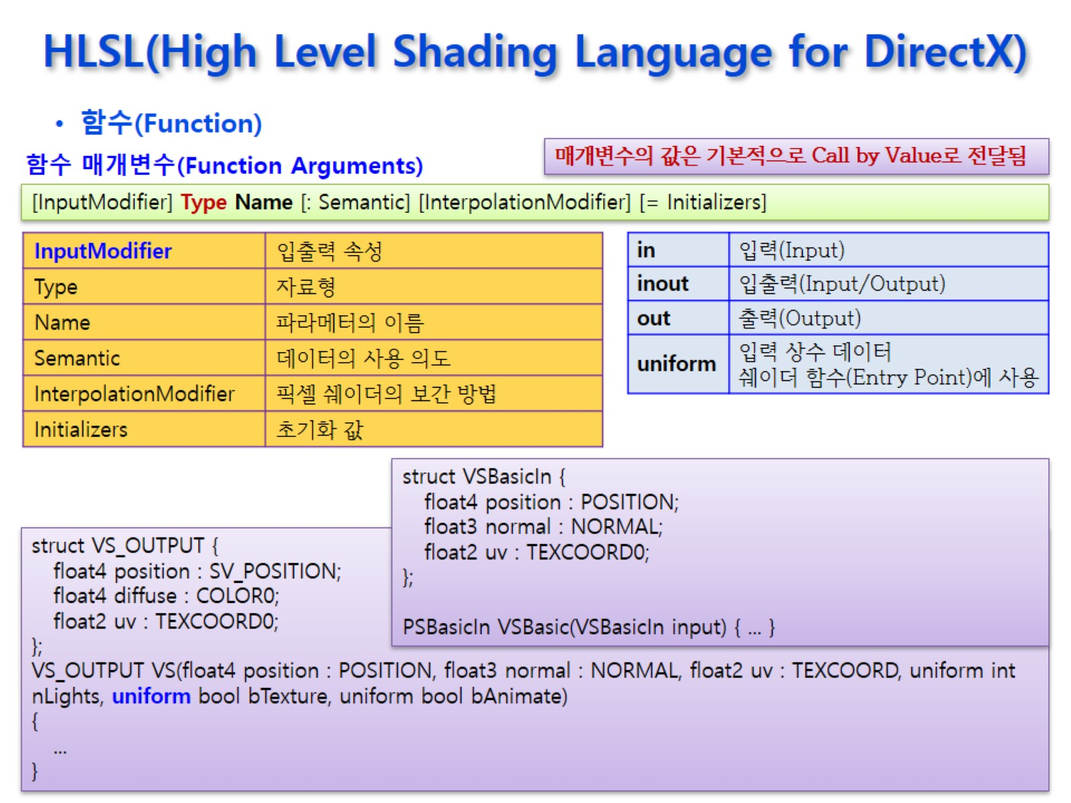
HLSL(High Level Shading Language for DirectX)

Slide 42
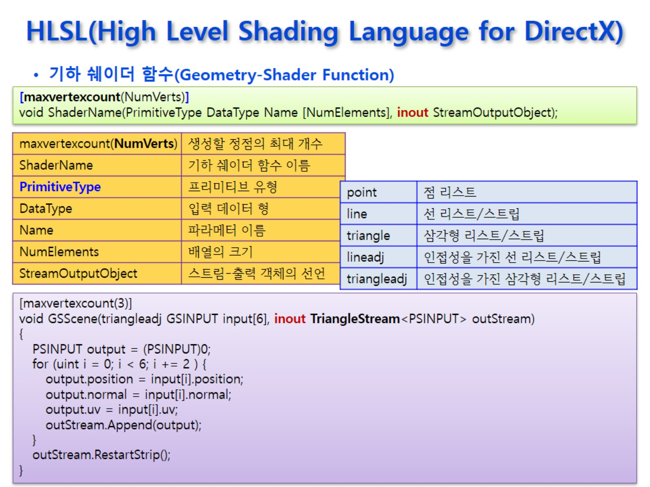
HLSL(High Level Shading Language for DirectX)

Slide 43
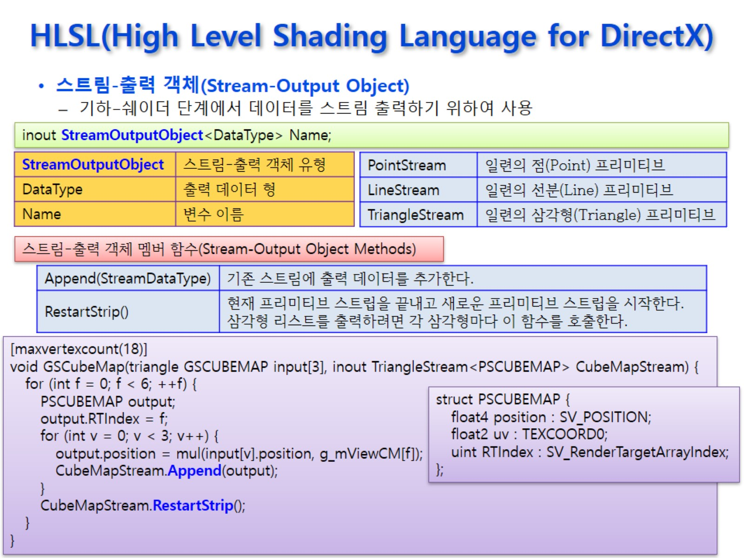
HLSL(High Level Shading Language for DirectX)

Slide 44
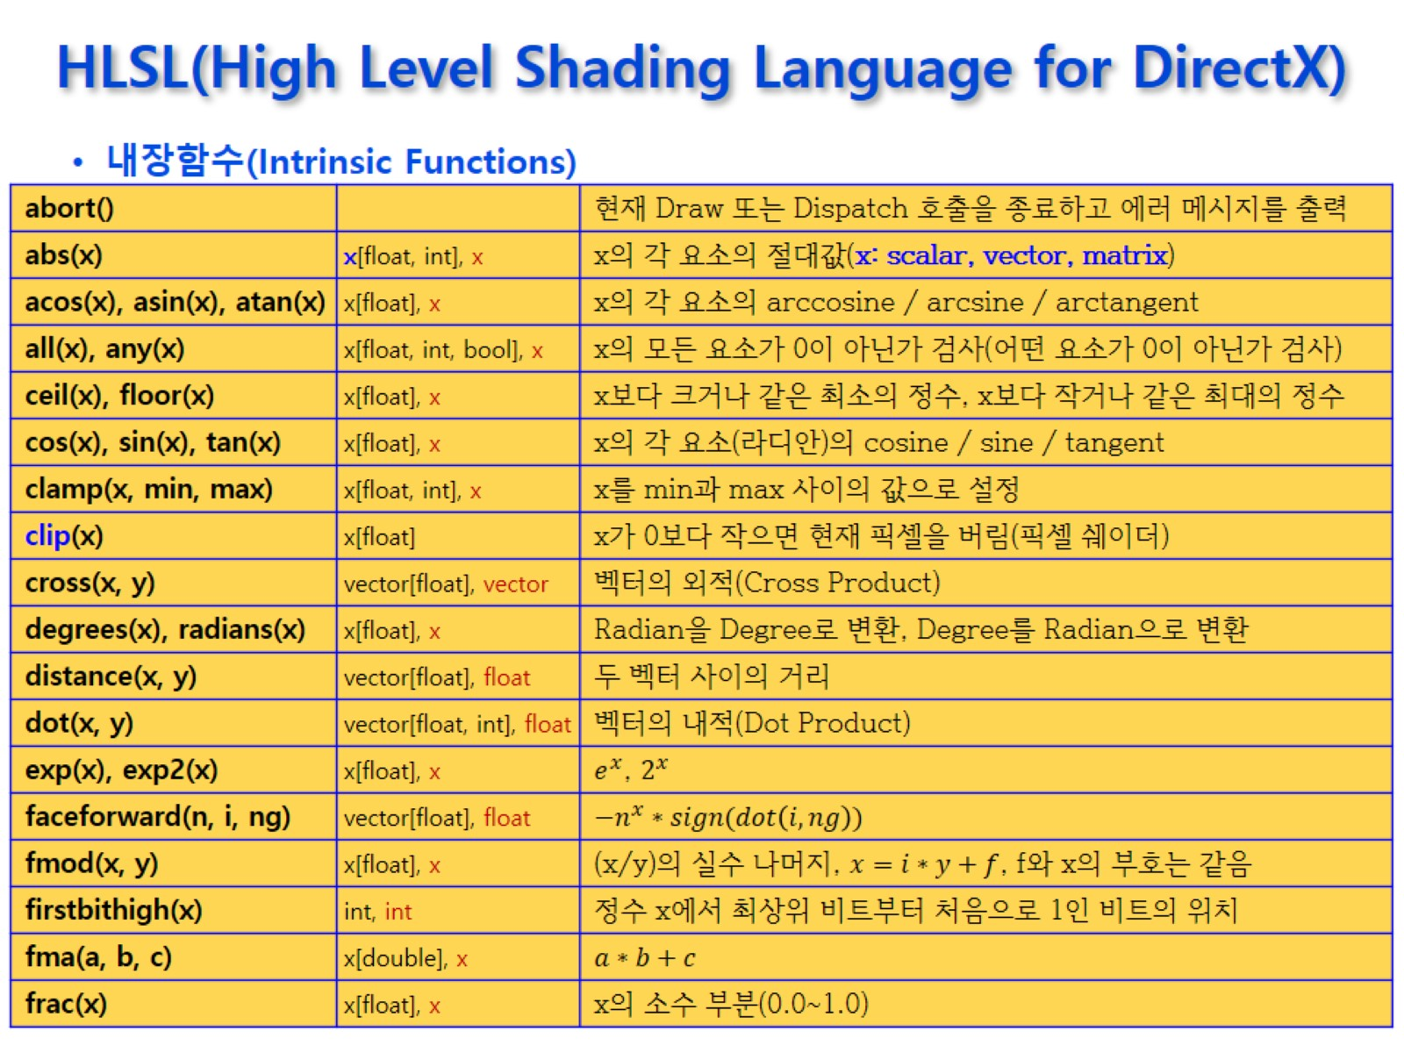
HLSL(High Level Shading Language for DirectX)

Slide 45
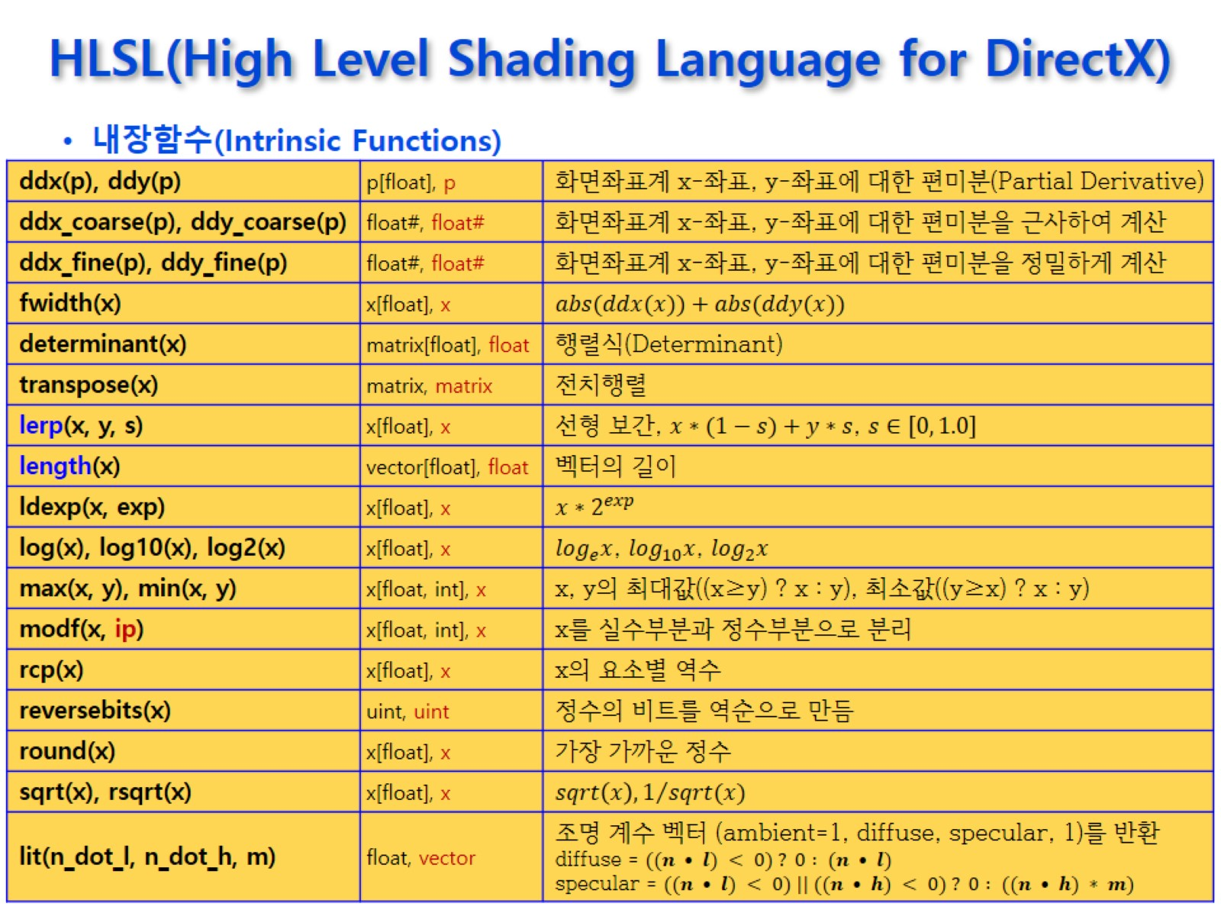
HLSL(High Level Shading Language for DirectX)

Slide 46
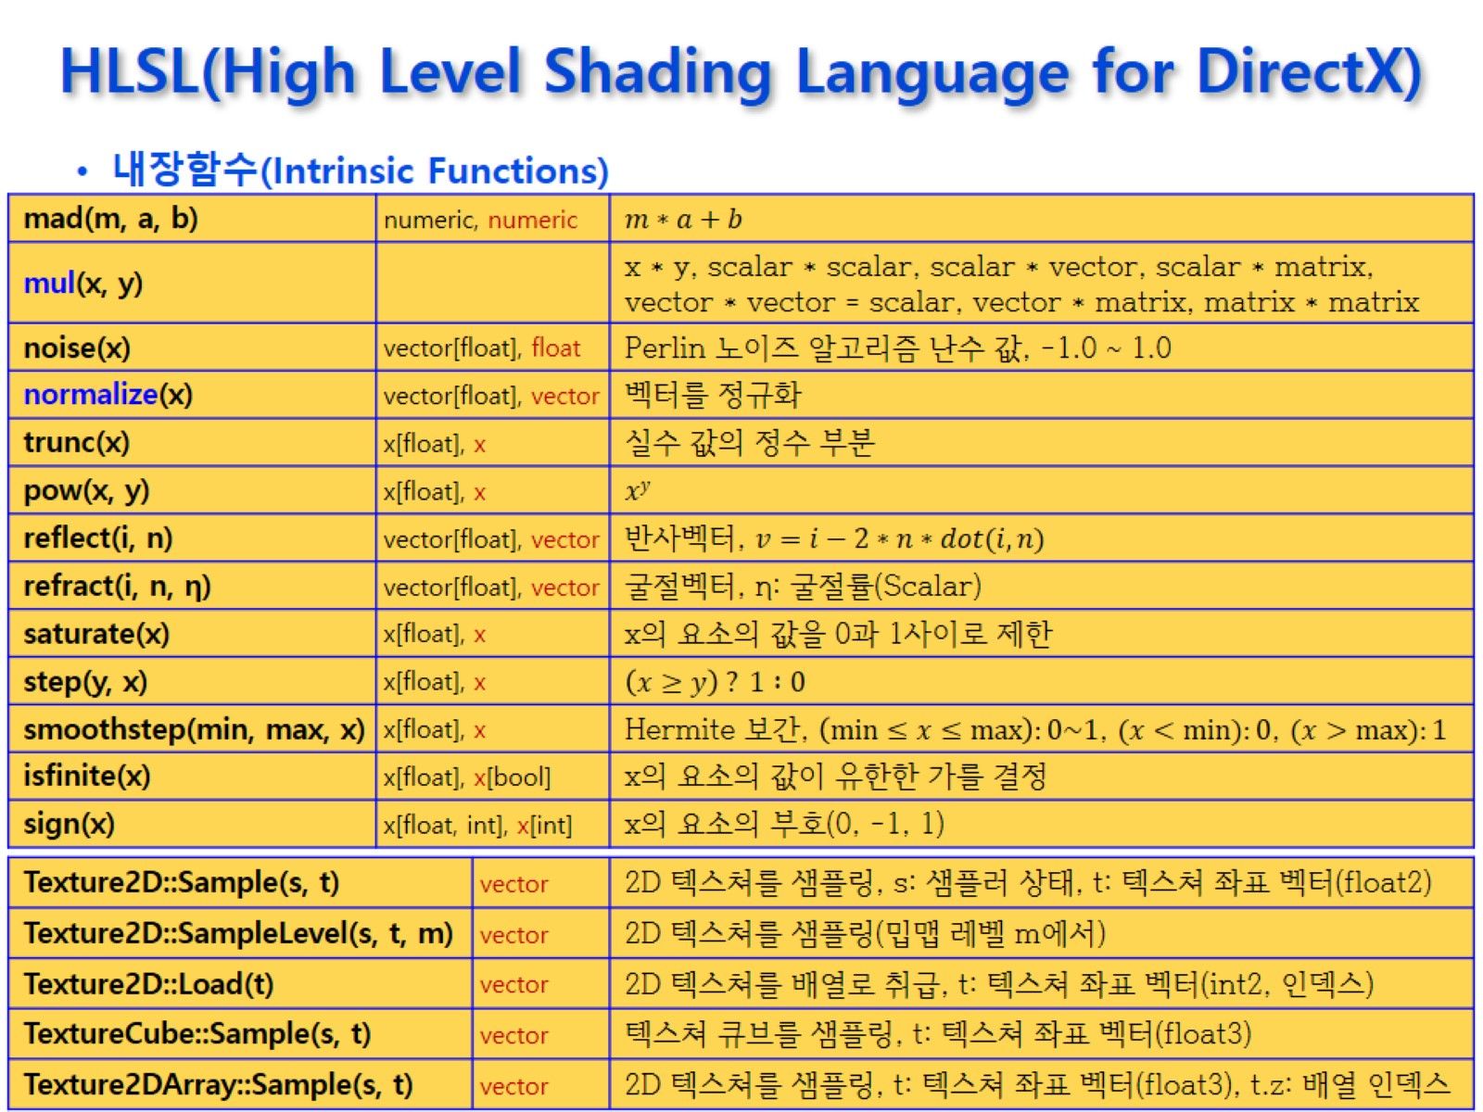
HLSL(High Level Shading Language for DirectX)

Slide 47
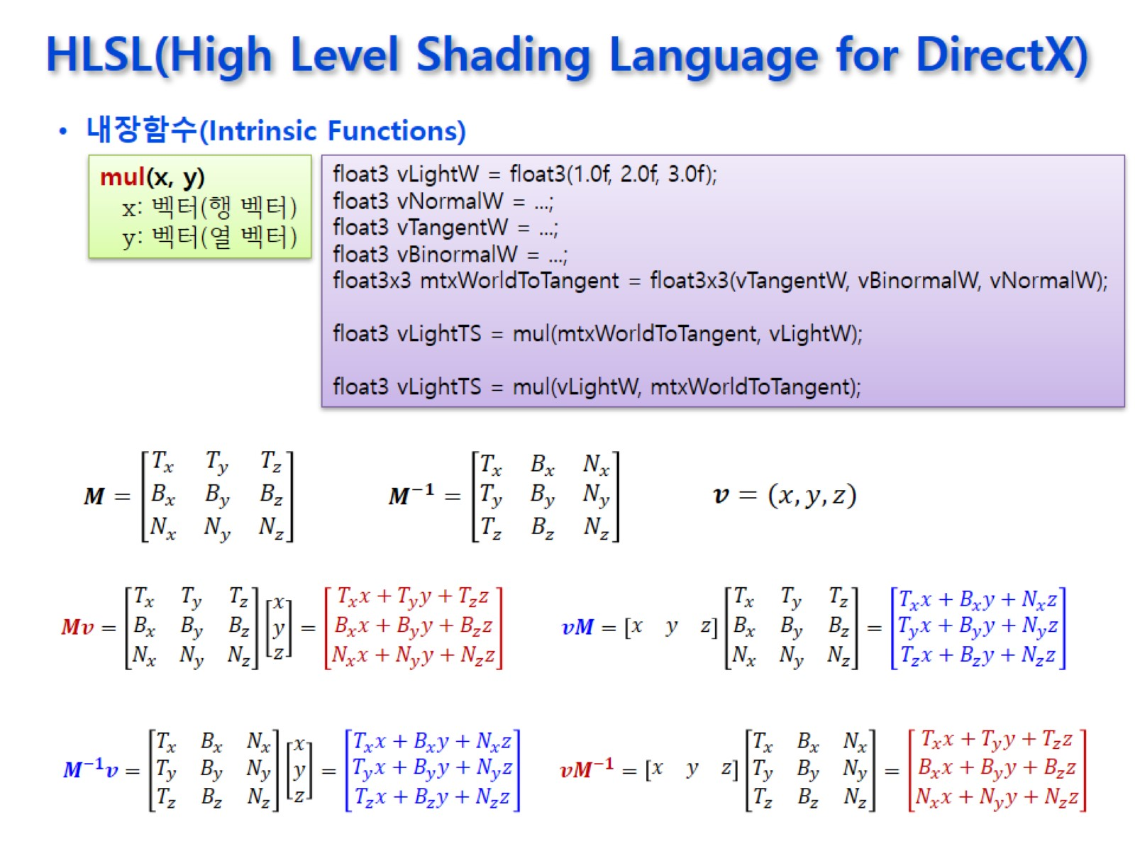



HLSL(High Level Shading Language for DirectX)
역행렬의 계산의 결과를 얻고 싶으면 행렬을 곱하는 순서를 바꿔서 사용
Notes:
게임에서 3x3행렬은 대부분 회전을 나타냄

Slide 48
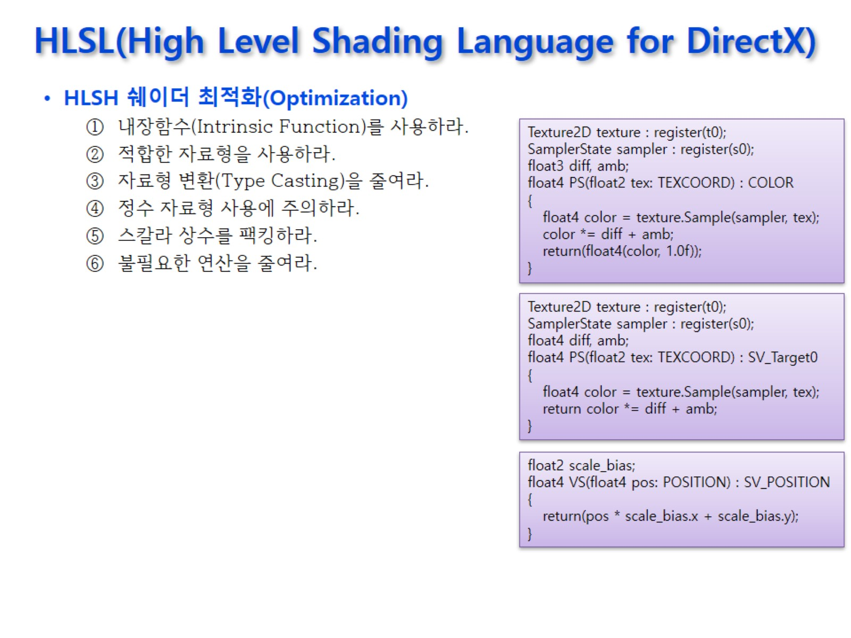
HLSL(High Level Shading Language for DirectX)
왠만하면 실수형 데이터를 써라

